Slide 1

Overview of the BioCyc.org Microbial Genomes Web Portal
Peter D. Karp ecocyc.org
SRI International biocyc.org
metacyc.org

Slide 2
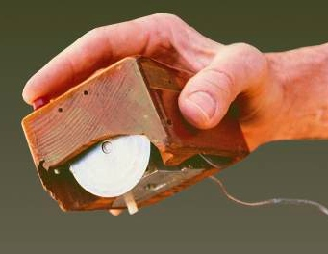

SRI International
A nonprofit multi-disciplinary research institute
  Founded by Stanford University in 1946
  Independent in 1970; changed name from
  Stanford Research Institute to SRI International in 1977
  More than 20 locations worldwide
BioCyc partners:
  Paulsen Lab, Macquarie University
  Collado-Vides Lab, National University of Mexico
SRI spin-off Siri, acquired by Apple in 2010 offerred a virtual personal assistant.
1964–1968: SRI’s Doug Engelbart and team invented the computer mouse and demonstrated the foundations of personal computing.

Slide 3
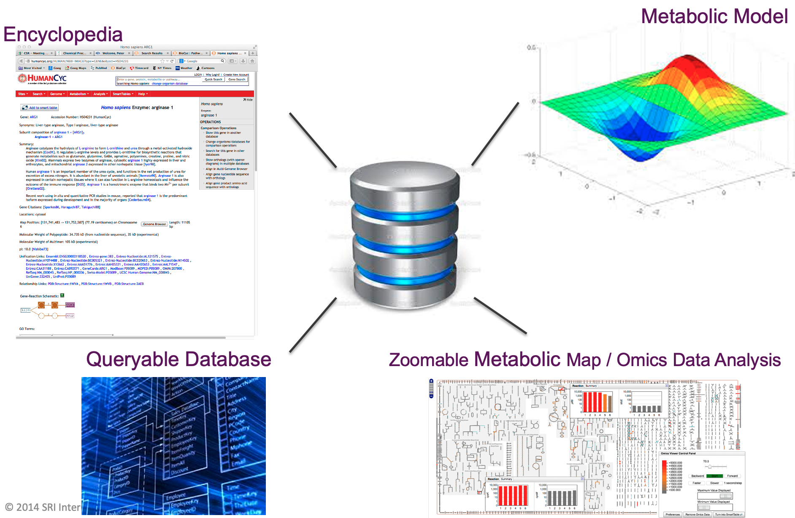
BioCyc Web Portal and Database Collection
Web portal that integrates genome and metabolic pathway data with powerful bioinformatics tools
Encyclopedic reference
  19,000 total databases
  60 curated databases, contents derived from 130,000 publications
    https://biocyc.org/biocyc-pgdb-list.shtml
Use cases:
  Information finding
  Transcriptomics data analysis
  Metabolomics data analysis
  Sequence analysis
  Comparative analysis
  Synthetic biology

Slide 4
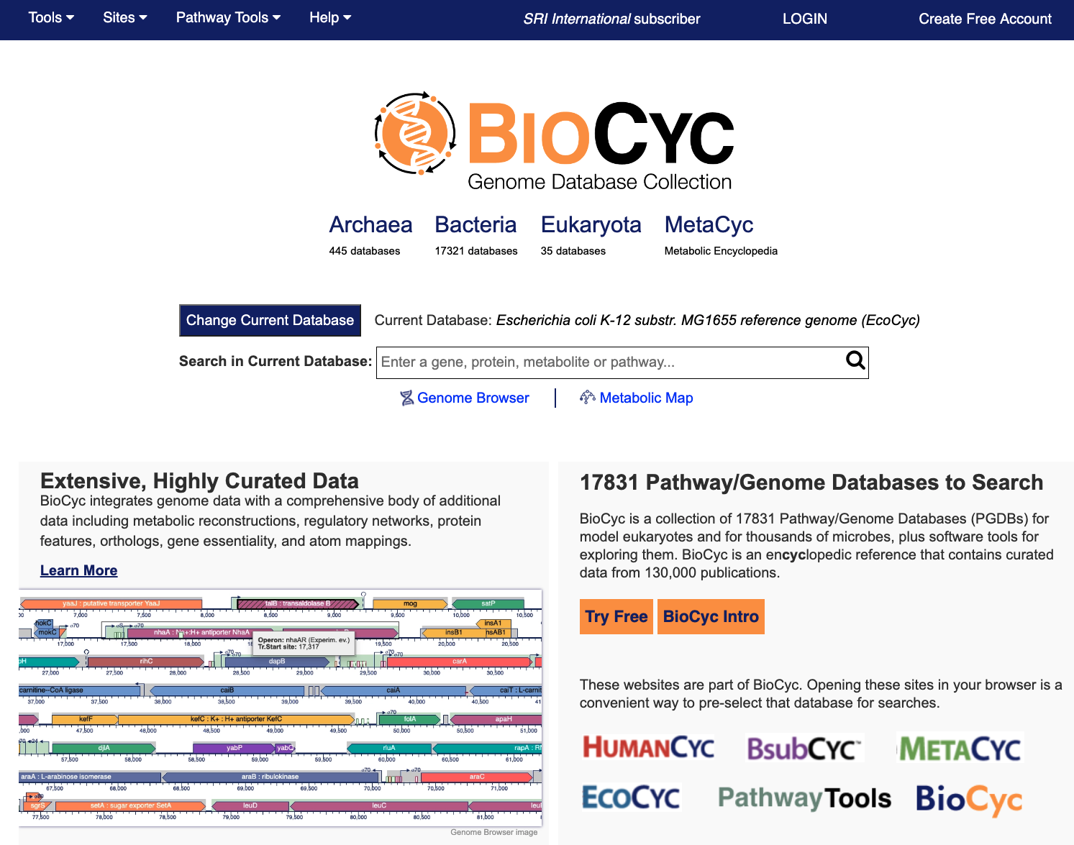
BioCyc.org Collection of 19,000
Pathway/Genome Databases
Pathway/Genome Databases (PGDB) combine:
  Pathways, reactions, substrates
  Enzymes, transporters, protein features
  Genes, replicons, regulatory network
  Gene essentiality, GO terms
Tier 1: Highly curated PGDBs
  MetaCyc, HumanCyc, YeastCyc
  EcoCyc -- Escherichia coli K-12
Tier 2: Moderately curated -- 60 PGDBs
  Bacillus subtilis, Mycobacterium tuberculosis
Tier 3: Computationally-derived DBs
Briefings in Bioinformatics 20:1085 2019

Slide 5
BioCyc Databases Include
Eukaryotic Model Organisms
Homo sapiens
Mus musculus
Rattus norvegicus (planned fall 2021)
Drosophila melanogaster
Caenorhabditis elegans (planned fall 2021)
Saccharomyces cerevisiae
Arabidopsis thaliana
Bold = Curated DBs
Full list of curated DBs:
https://biocyc.org/biocyc-pgdb-list.shtml
Bacteria
Escherichia coli
Bacillus subtilis
Mycobacterium tuberculosis
Salmonella enterica
Acinetobacter baumannii
Chlamydia trachomatis
Corynebacterium glutamicum
Lactobacillus rhamnosus
Pseudomonas putida
Sinorhizobium meliloti
Staphylococcus aureus
Synechococcus elongatus
Vibrio cholerae

Slide 6
MetaCyc: Metabolic Encyclopedia
Experimentally determined metabolic pathways, reactions, enzymes, and compounds
Metabolism from all domains of life
Literature-based DB with extensive references and commentary
  Derived from 68,000 publications
Extensive information on pathway variants
  8 variants of the TCA cycle
  6 variants of L-lysine biosynthesis
Nucleic Acids Research 2020 Database Issue

Slide 7
Creation of BioCyc Databases (PGDBs)
Computational Inferences
NIH RefSeq
Predict metabolic reactions
Predict operons
Predict transport reactions
Compute orthologs
Predict metabolic pathways
Compute Pfam domains
Predict pathway hole fillers
Curation: Tiers 1-2
PGDB
Metabolic Model
Regulatory data [regtransbase]
Database links
Subcellular locations [psortdb]
Gene essentiality data
GO terms [uniprot]
Protein features [uniprot]
Data Import

Slide 8
Curation Tasks
Perform literature searches for new gene functions, pathways
Author mini-reviews, insert citations and evidence codes
Update database fields
  Gene names, synonyms, protein functions, activators, inhibitors
Define protein complexes
Review and extend enzyme/transporter reaction associations
Review predicted metabolic pathways
Define TF binding sites, promoters, regulation of transcription initiation and other processes

Slide 9
BioCyc Subscriptions
Two free databases:
  EcoCyc – Escherichia coli K-12
  MetaCyc – Universal metabolic database
Subscriptions support our curation efforts for other databases
  Institutional subscriptions
  Personal subscriptions
  How to check if your institution already subscribes
    Look for “[Institution Name] Subscriber” in top banner
Limited free page views to the subscription-only databases

Slide 10
BioCyc and Pathway Tools Capabilities
Genome Informatics
  Gene/protein/RNA searches, gene information page
  Genome browser
  BLAST search
  Sequence pattern search
  Multiple sequence alignment
  Sequence retrieval
Pathway Informatics
  Reaction/metabolite/pathway searches and info pages
  Infer metabolic network from genome
  Zoomable metabolic network diagrams
  Metabolic network explorer
  Metabolic route search for single organisms and communities
  Pathway-based inference of nutrient requirements
  Metabolic modeling using flux-balance analysis
    FBA, dFBA, FVA, gap filling, blocked metabolites
Regulatory Informatics
  Capture/visualize promoters, transcription factor binding sites
  Visualize regulon of transcription factor
  Regulatory network viewer
  Operon inference
Microbiome Informatics
  Calculate pathway abundances across metagenome samples
  Create PGDBs for an organism community
  Analysis of meta-omics data
Comparative Analysis
  Search across PGDBs for genes, proteins, pathways, metabolites
  Comparative genome browser
  Compare pathway, reaction, and metabolite complements
Transcriptomics and Metabolomics Data Analysis
  Enrichment analysis
  Paint transcriptomics data onto pathways, zoomable metabolic network
  Omics Dashboard
  Sort pathways by pathway activation score
  Pathway covering analysis
Advanced Data Manipulation
  SmartTables
  Advanced Query Interface
  Interactive editing tools
  APIs: Python, Perl, Java, Lisp, R, web services
  Import/Export: SBML, GenBank, GFF3, BioPAX, tab-delimited files

Slide 11
Tutorial Series Overview
Today
  Database selection and search operations
  Gene, metabolite, reaction, pathway pages
  BLAST search, sequence pattern search, extracting sequences
  Regulation in BioCyc
  Update notifications
November 10
  Genome browser
  SmartTables
  Comparative operations
November 17
  Metabolic network browser and omics viewer
  Omics Dashboard
  Displaying high-throughput data on individual pathways and metabolic network diagrams
  Pathway collages
  Enrichment analysis
  Pathway covering
BioCyc webinars: https://biocyc.org/webinar.shtml

Slide 12
Main BioCyc Page Types
Gene/protein/RNA
Transcription Unit
Pathway
Reaction
Metabolite

Slide 14
EcoCyc Project – EcoCyc.org
E. coli Encyclopedia
  Review-level Model-Organism Database for E. coli
  Derived from 40,000 publications
“Multi-dimensional annotation of the E. coli K-12 genome”
  Mini-review summaries (3,669 pages) and literature citations
  Evidence codes
  Gene Ontology annotations (64,000)
  Protein features (active sites, metal ion binding sites): 40,050
  Multimeric complexes: 1102
  Metabolic pathways (360), reactions (2167), metabolites (3054)
  Regulation of gene expression (3900) and of protein activity (2760)
  Gene essentiality data (8 / 16,000)
  Growth under alternative nutrient conditions (437)
Nucleic Acids Research 2017 Database Issue

Slide 15
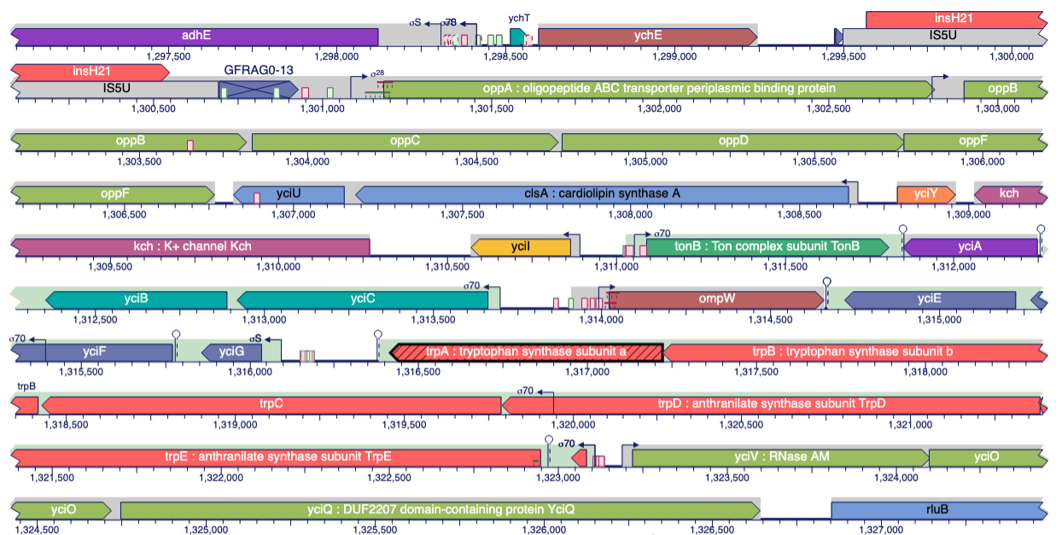
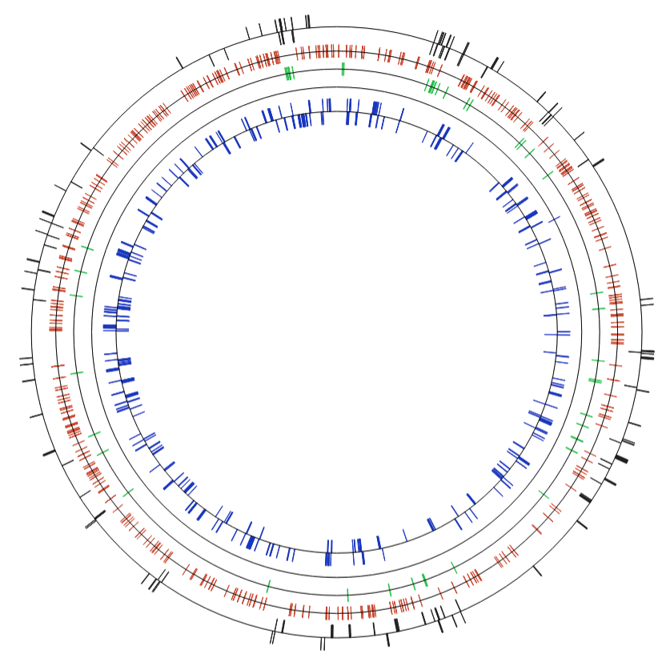
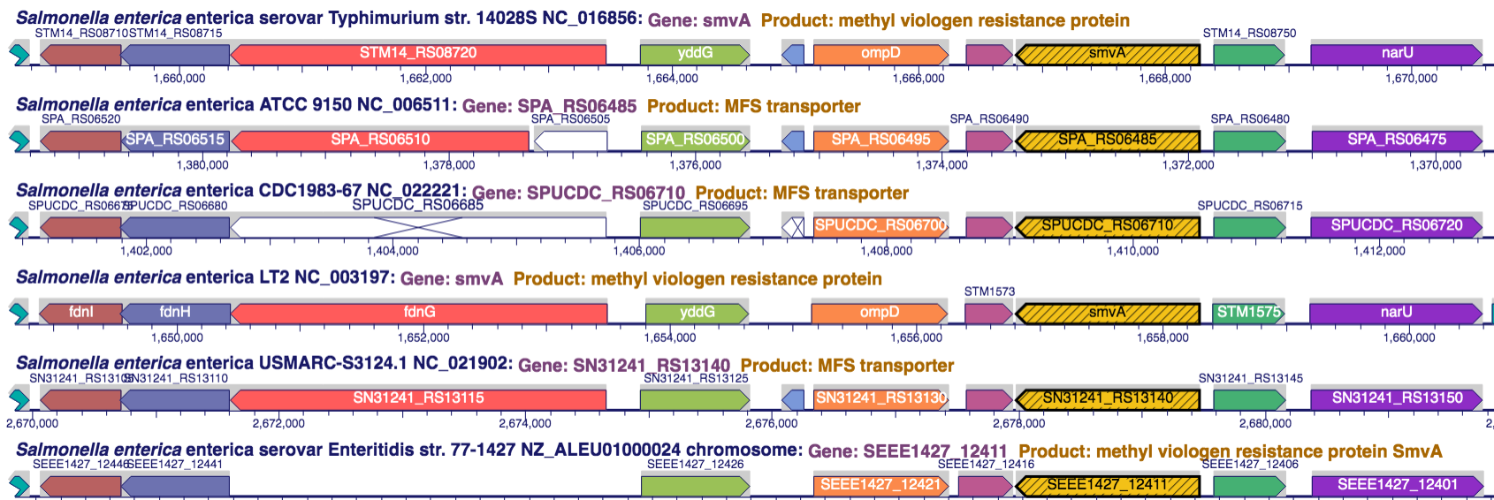
Genome Informatics
Gene/Protein/RNA Search, Genome Site Search
Gene information page
  Retrieve sequence of gene or genomic region
Transcription-unit page shows regulatory sites/interactions
BLAST search, sequence pattern search, sequence alignment
Map SNPs to genes, show effects on translation
Genome browser
  Zoom full chromosome to sequence
  Comparative mode, tracks facility
  Omics data painting , genome poster

Slide 16
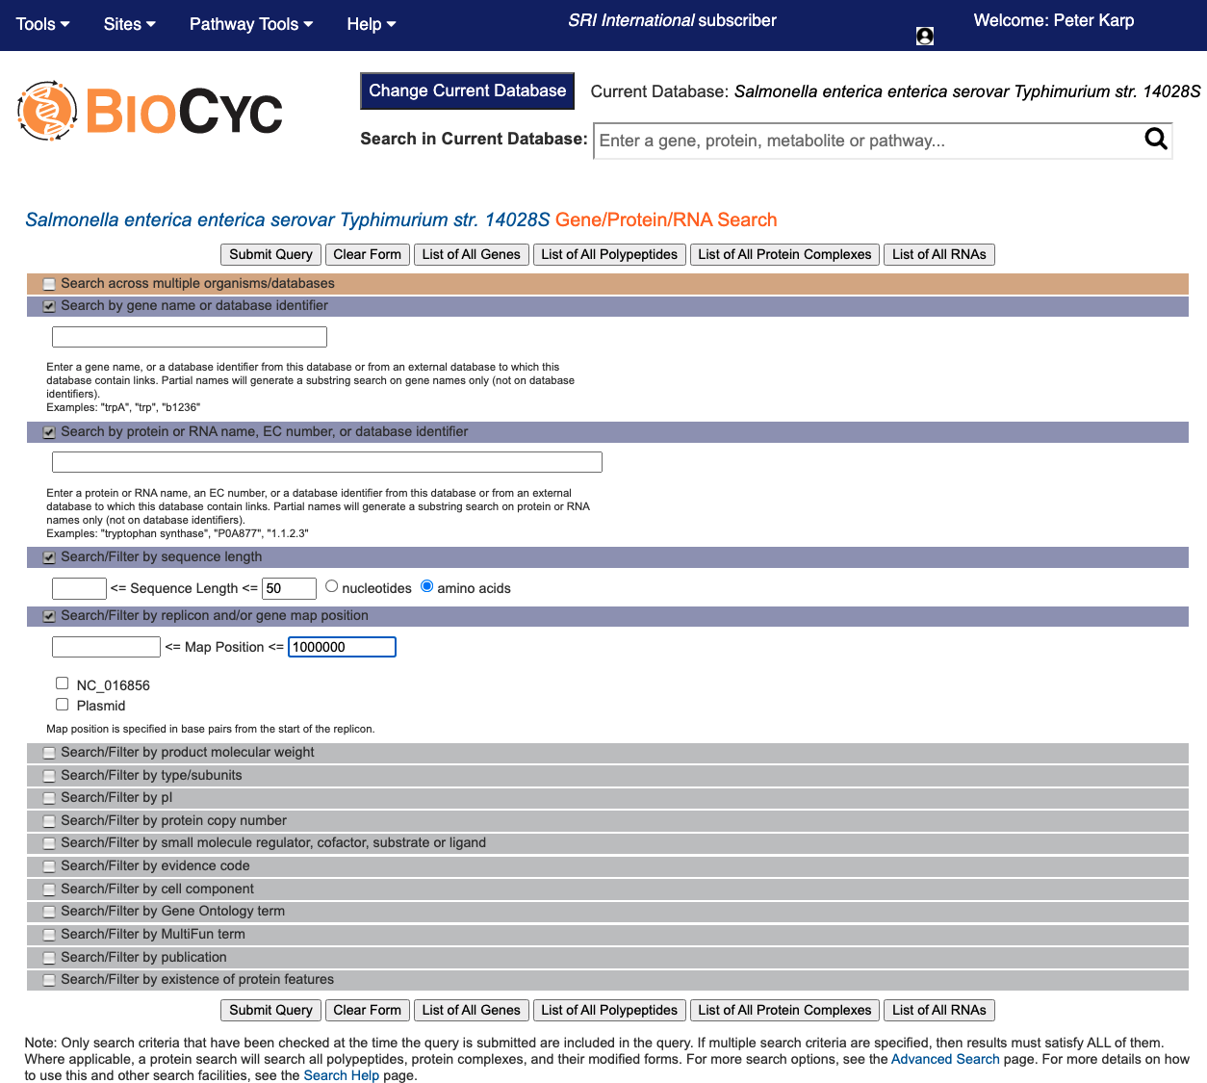

Slide 17
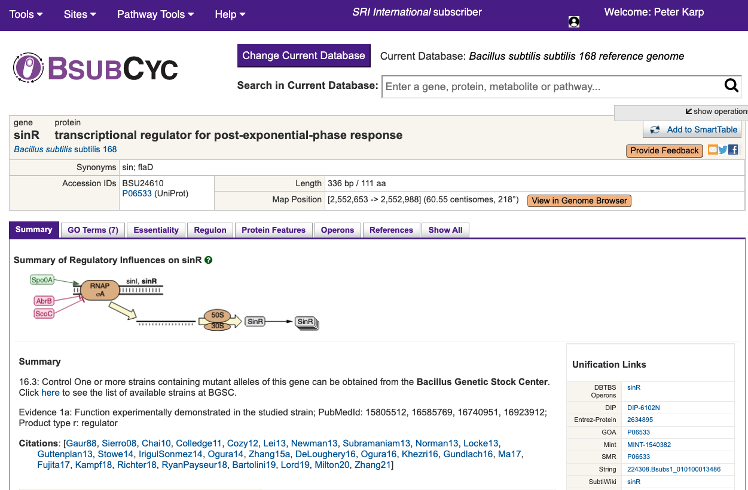

Slide 18
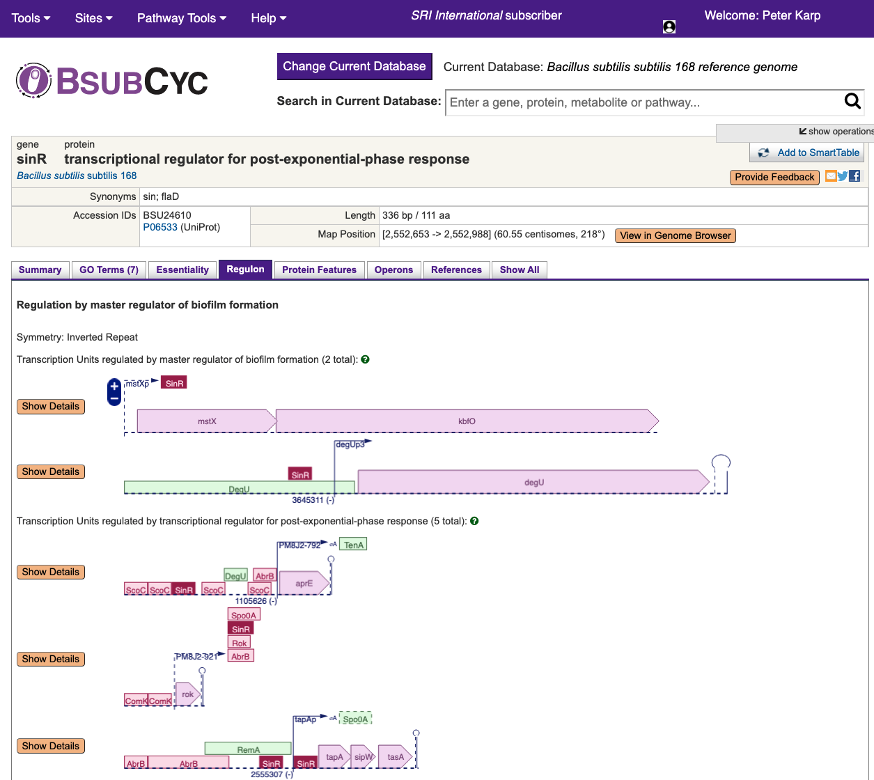

Slide 20
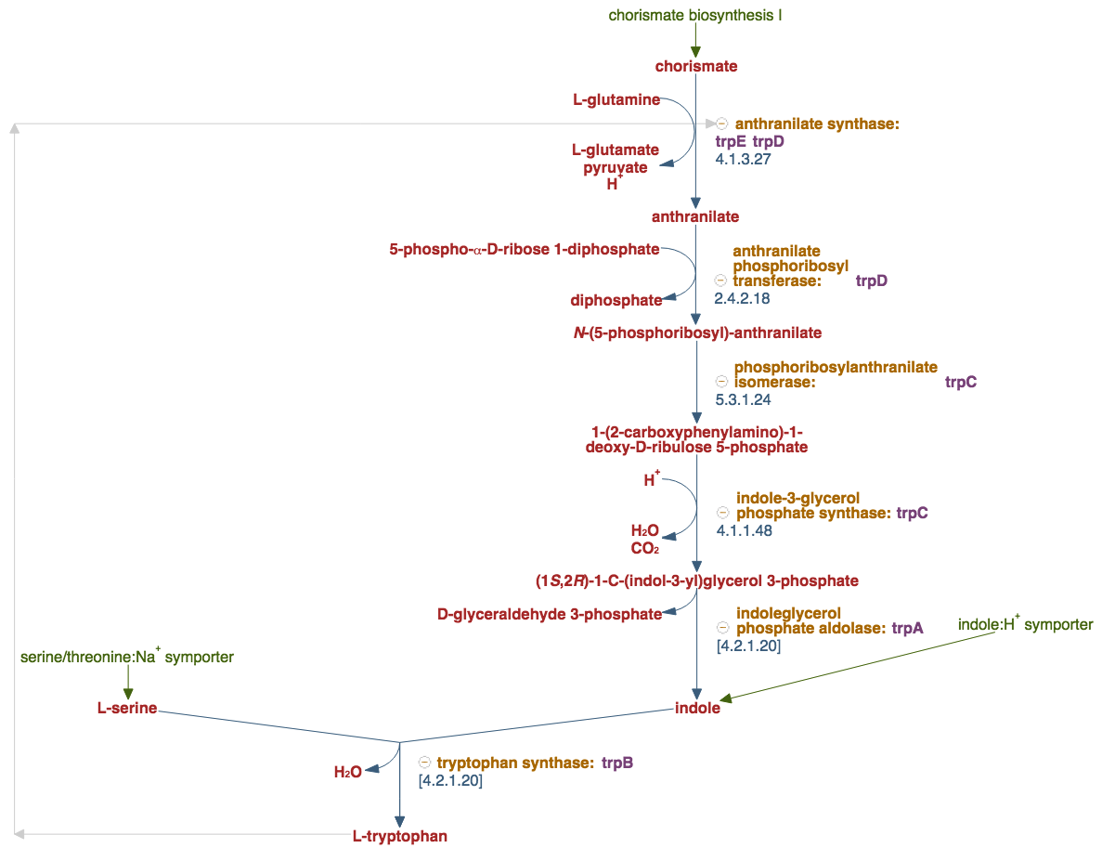
Pathway Informatics
Pathway search, information page
  Customize pathway diagram for publication
  Create personalized multi-pathway diagrams
  Comparative pathway analysis
Reaction search, reaction information page
  Shows reaction atom mappings
Metabolite search, metabolite information page
  Search by name, substructure, monoisotopic mass, elemental composition
  Show all reactions, pathways, regulatory effects of metabolite
Zoomable organism-specific metabolic map diagram
  Generate metabolic-map poster
Metabolic route-search tool computes optimal paths
Execution of quantitative metabolic flux models

Slide 21
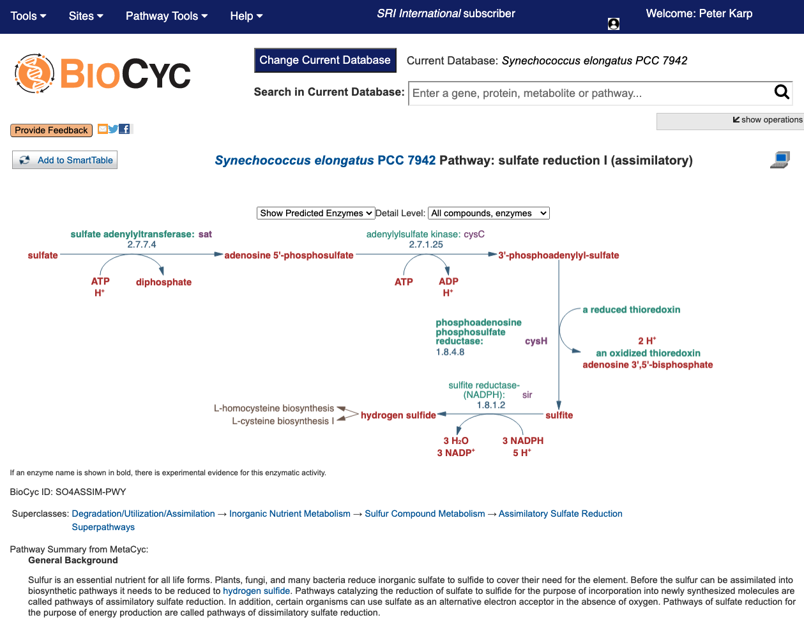

Slide 22
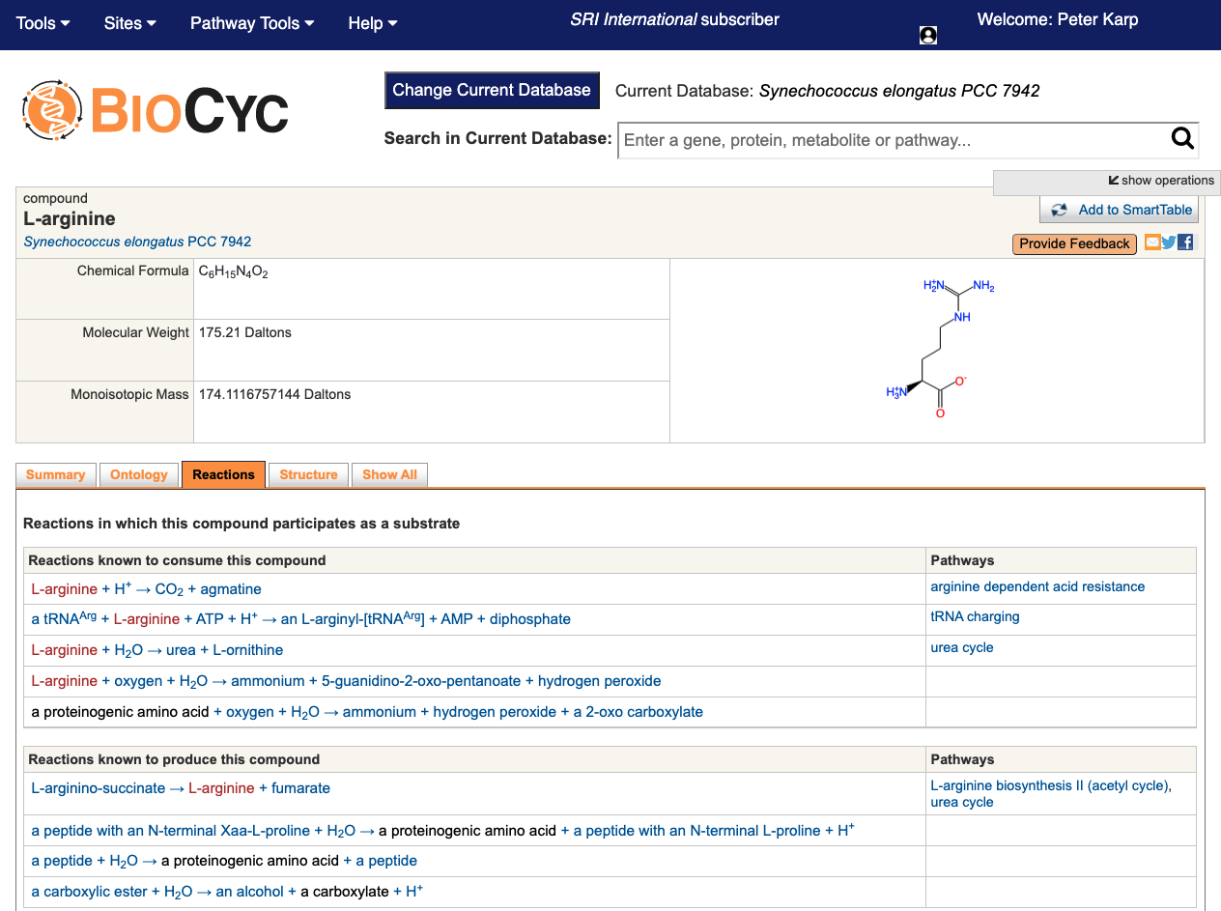

Slide 23
BioCyc Analysis Tools

Slide 24
BioCyc Omics Analysis Operations
Transcriptomics, proteomics, metabolomics
Paint data onto pathways, pathway collages, metabolic maps
Omics Dashboard
Enrichment analysis: Compute pathways statistically over represented
    Pathways over represented in gene or metabolite sets
    GO terms over represented in gene sets
    Regulators over represented in gene sets

Slide 25
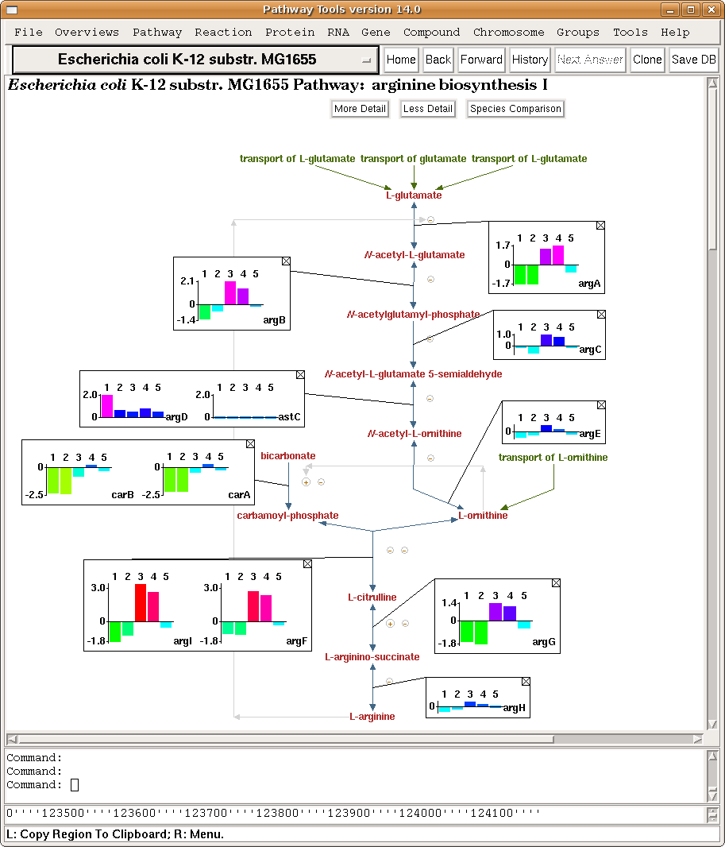
Gene Expression Data on
Single Pathway

Slide 26
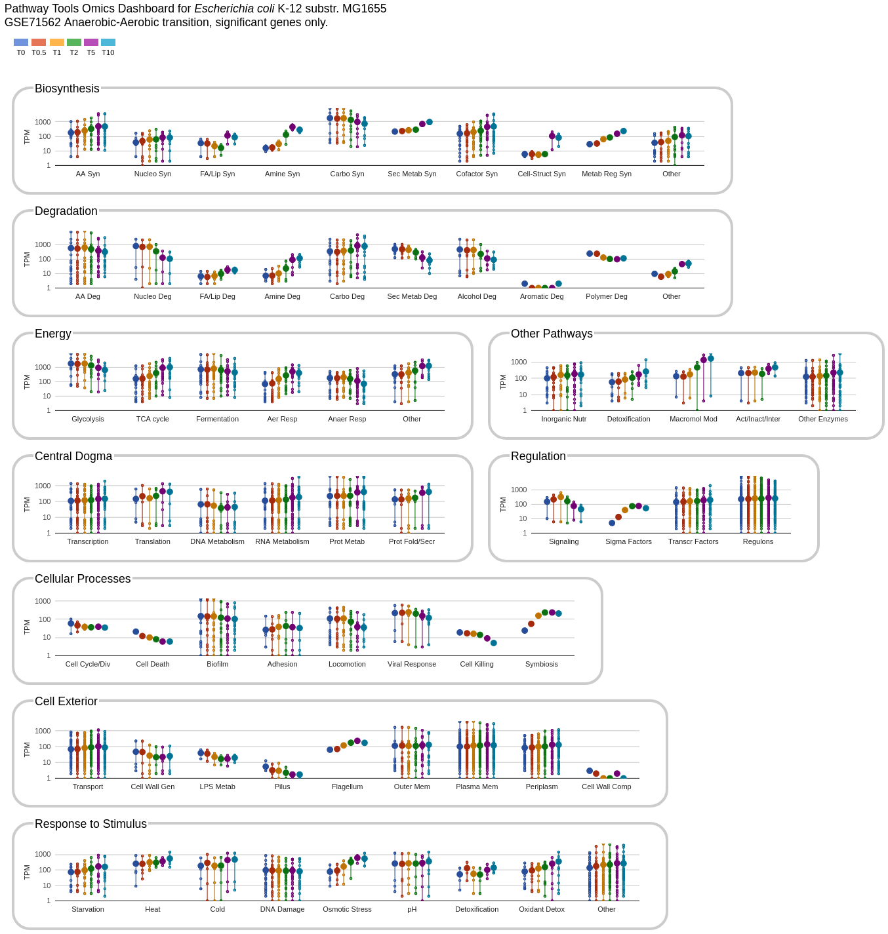
Organization of Omics Dashboard
A series of panels summarize omics data for different cellular systems
Each panel contains a set of plots (subsystems)
Large dots average measurements
Notes:
Each point on a vertical line is a reading for one gene.
Set of metabolites on one vertical line are all genes in that subsystem for which data is available.
Large point is the average.

Slide 27
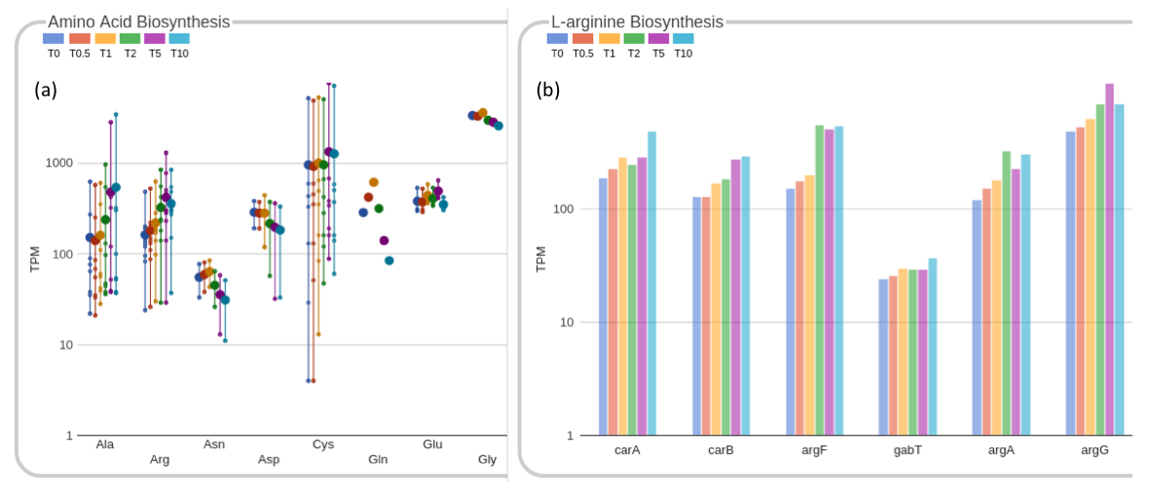
Drilling Down within Amino Acid Biosynthesis Plot

Slide 28
SmartTables
Collect and save lists of database objects
  Genes, metabolites, pathways, sequence regions, …
Explore properties interactively
Filter and combine (union, intersection, subtraction)
Transform them into related objects (eg: gene list → pathway list)
Share with public or specific collaborators, publish

Slide 29
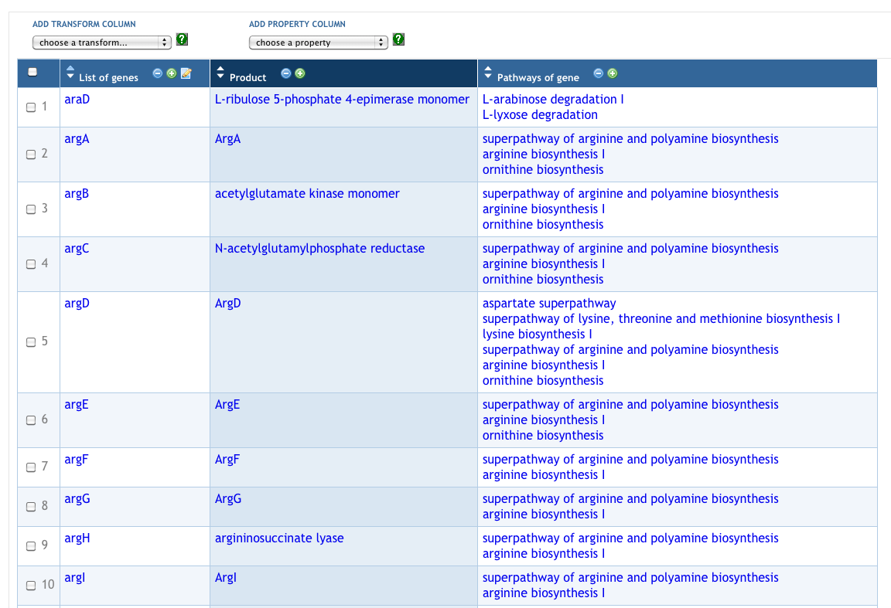
SmartTables
Import from files
Create from query results

Slide 30
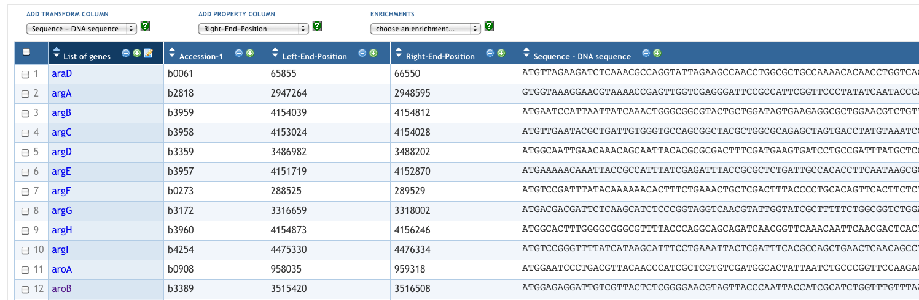
Manipulate Genes and Sequences

Slide 31
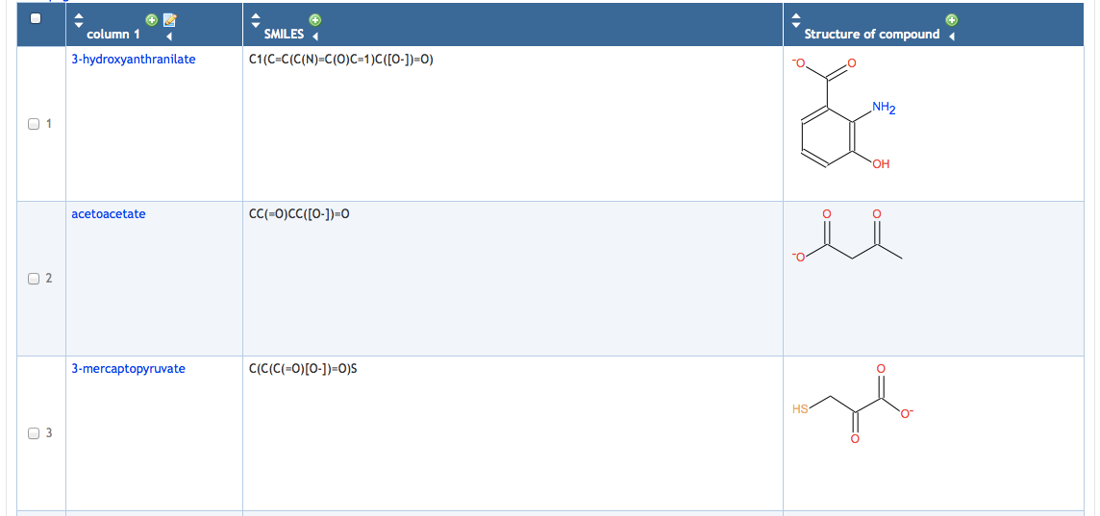
Using SmartTables: Browsing Database Attributes

