Slide 1

Comparative Tools, Searches, SmartTables, and Regulatory Overview
Peter E. Midford ecocyc.org
SRI International biocyc.org
metacyc.org

Slide 2
Tutorial Overview
Comparative Genome Browser
Orthologs in BioCyc
Blast Searching in BioCyc
Cross Organism Search
Multi-organism Search
Comparative Analysis Tables
Using SmartTables to store, share, and analyze lists of genes and metabolites
Regulatory Overview

Slide 3
Comparative Genome Browser
To enter, in Gene page, click on “Align in Multi-Genome Browser”
“Select Allowed Organisms” to set or adjust which organisms to compare with
Comparison only works with organisms with computed orthologs
The selected gene is centered, and aligned with Orthologs in the other PGDBs
Colors mean shared Orthologs. A dozen colors are reused.
Notes:
3
3
3

Slide 4
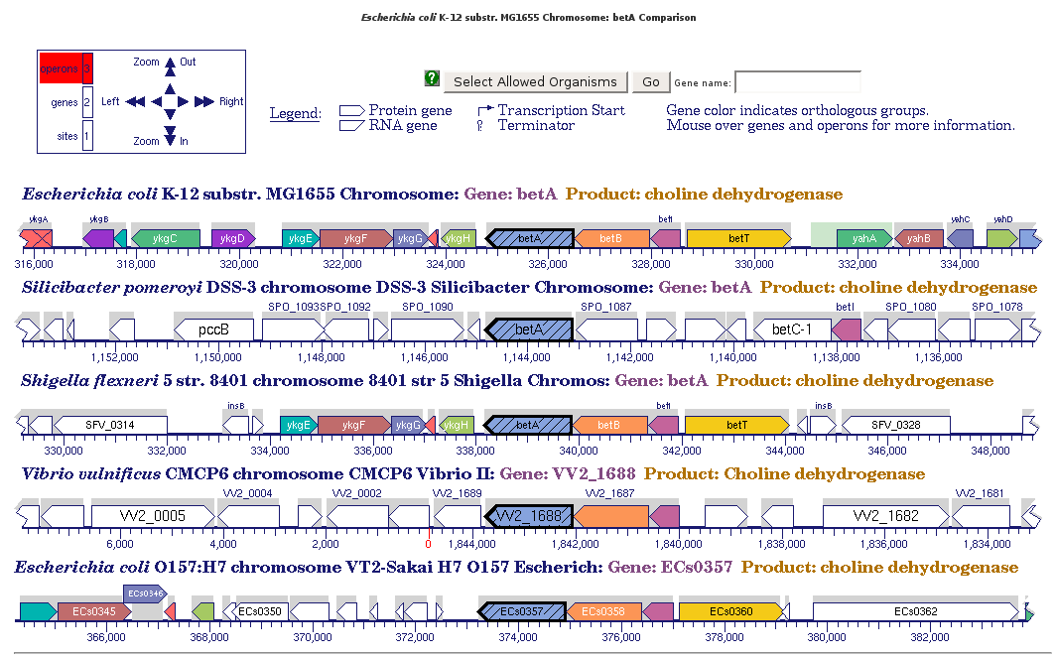
Comparative Genome Browser Display
Notes:
4
4
4

Slide 5
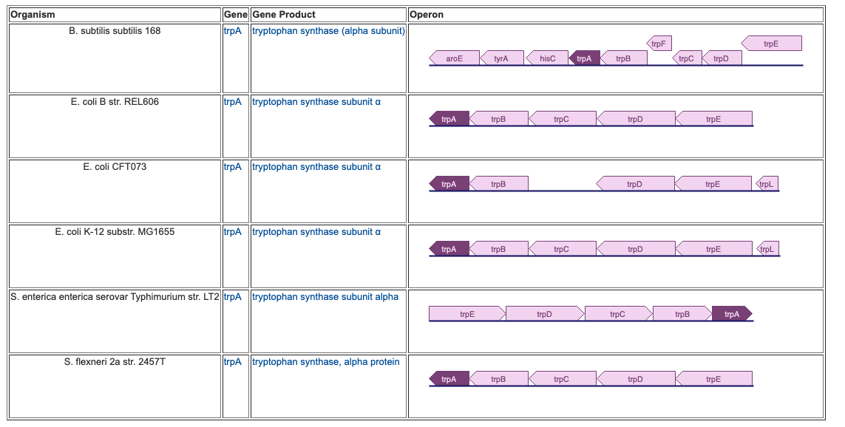
Orthologs Display
Not all organisms have orthologs computed
Start from a Gene page
Show orthologs in multiple databases

Slide 6
Blast Search
Search Protein/Nucleotide sequences
  Single Organism Database or
  All databases in BioCyc
Searching single organism is very fast
Blast results page has links to results

Slide 7
Sequence Pattern Search
Tools -> Search -> Sequence Pattern Search
Search for protein or nucleotide sequences that match short patterns
Supports a pattern matching language
Language is documented on search page

Slide 8
Cross Organism Search
Tools-> Cross Organism Search
Text search for substrings in names (including synonyms) and summary fields
No limit on the number of organisms you can search against
Can search across multiple types of object
Matches may need any or all terms in set

Slide 9
MultiOrganism Search
General search (features, not just text match) across objects of a particular type across up to 70 organisms
An option in the main search menus and just extends those same searches across a set of organisms
Select the ”Search across multiple organisms” – menu will expand to show a dialog for selecting organisms or an existing set
This isn’t a text search; you can search for any of the properties available for the type you are searching for.

Slide 10
Comparative Analysis Tables
Tools -> Analysis -> Comparative Analysis
Select a set of organisms and a set of object types
Result is a set of tables for each object type, each organism in a column
These tables provide lots of links for drilling down to get more detailed reports
Table of contents for navigating tables

Slide 11
SmartTables
Define lists of database objects
  Genes, metabolites, pathways, sequence regions, …
Browse their properties
Transform them into related objects
(eg: transform list of genes → list of pathways)
Filter and combine
Share with public or specific collaborators
Export to spreadsheet
Omics analyses

Slide 12
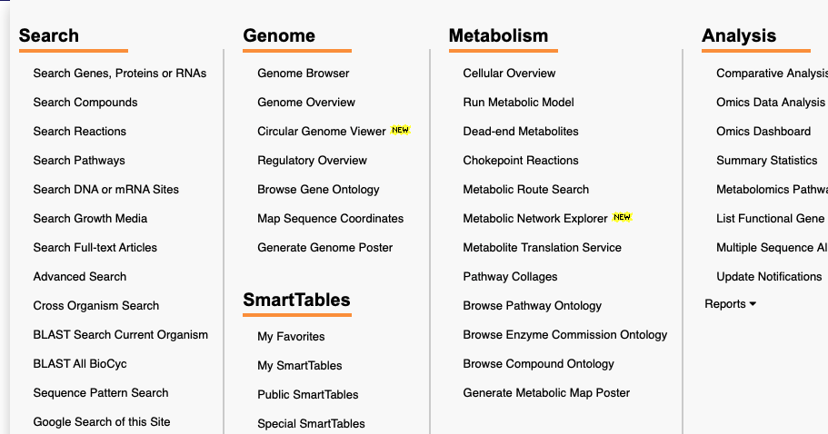
SmartTables Location
Tools->SmartTables->My SmartTables
Almost all SmartTable operations require you to create a (free) BioCyc account for yourself

Slide 13
Three Types of SmartTables
Created by you
Created by other users (public/private)
  Tools -> SmartTables -> Public SmartTables
  Make your own copy to edit
Special
  Tools -> SmartTables -> Special SmartTables
  All pathways, all metabolites
  Also see SmartTable buttons on Organism Summary Page
  (Tools -> Analysis -> Summary Statistics)

Slide 14
Creating SmartTables
SmartTables are associated with a PGDB
Only objects in that PGDB can be added to a SmartTable
SmartTable rows and columns can contain
  PGDB objects and data fields
  Text strings that are not bound to a PGDB object

Slide 15
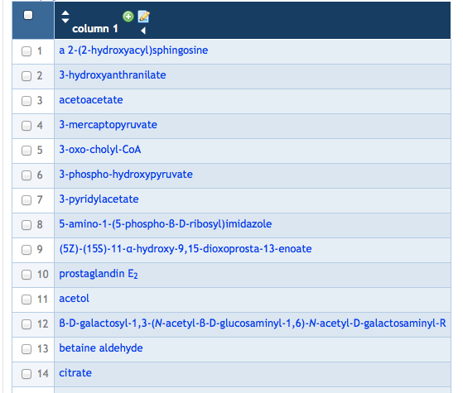
Creating SmartTables: User-Defined SmartTables
Create a SmartTable
  Type in metabolite names
  From search results
  Upload a tab-delimited text file

Slide 16
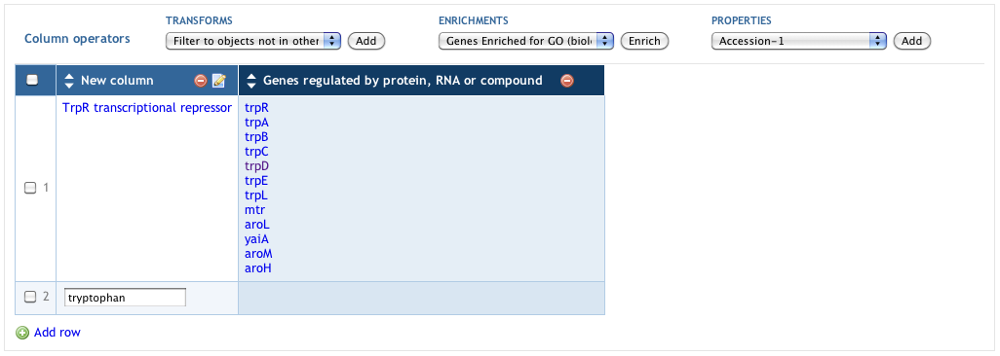
Creating SmartTables: User-Defined SmartTables
Create a SmartTable by typing in names
Operations -> New -> SmartTable of Objects from Text Entry
Names will be converted to rows of objects

Slide 17

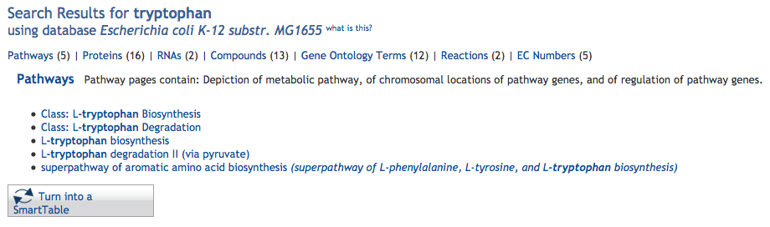
Creating SmartTables from Search Results
“Turn into a SmartTable” button appears on all search results

Slide 18
Using SmartTables: Attributes
Find the chromosome positions of all genes encoding enzymes of a pathway, sort by position. Find regulators of those genes.
Create a group that contains the pathway.
In the “Transforms” menu, select “Genes of pathway”.
Select gene column and select
  Operations > New > Group from column OR
  Click “+” at top of gene column
Select “left-end-position” from “Add Property Column” menu and add.
Sort by position by clicking on arrow in column header.
Select “Direct regulators of gene” from “Add Transform Column” menu.

Slide 19
Using SmartTables: SmartTable Transformations
Find all genes that are regulated by a transcriptional regulator.
Create a SmartTable that contains the transcription factor.
In the “Transforms” menu, select “Regulation – genes regulated by polypeptide, complex, or RNA”.
A new column containing all genes regulated by the transcription factor is generated.
This SmartTable can be further transformed, e.g. into metabolic pathways.
The resulting lists can be exported.

Slide 20
Other Operations on SmartTables
Set union, intersection, difference among two SmartTables
Filter SmartTable rows to keep/reject all rows containing specified value or substring or regular expression
Share SmartTable with public or specified users
Freeze SmartTable for publication

Slide 21
Regulatory Overview
Tools -> Genome -> Regulatory Overview
Displays transcriptional regulatory interactions among genes (when available)
BioCyc databases can include information for both protein and small RNA transcriptional regulators
Transcriptional information is also found in the regulon tab of gene pages and transcription unit pages

Slide 22
Regulatory Overview
Diagram with 3 ovals of genes (grey shapes/icons)
Right-side operations menu
Data-layer box
Opacity control
Zoom control
  Use control on left side or mouse wheel (preferred)

Slide 23
Regulatory Overview
Roll over gene to see details window
  Click ‘keep’ button to hold window open
  Indicates how many regulators and regulatees (genes its product regulates)
  Right click to highlight the gene, its regulators, its regulatees, or save report to a file
Right-side operations menu
Data-layer box
Opacity control
Zoom control
  Use control on left side or mouse wheel (preferred)

Slide 24
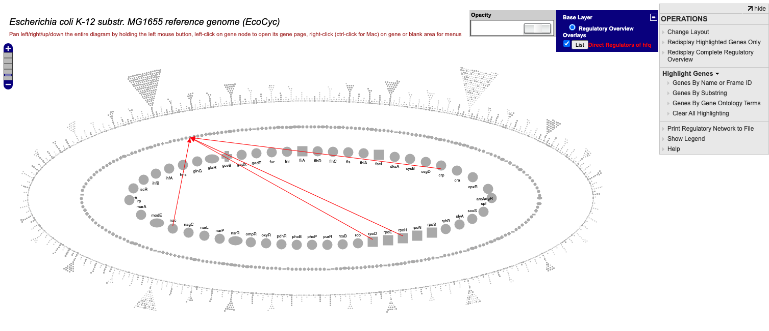
Regulatory Overview

