Slide 1

The consistency Checker, or Overhauling a PGDB
By Ron Caspi
Notes:
This presentation takes about 40 minutes

Slide 2
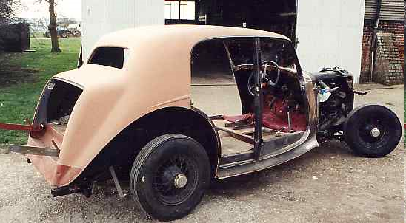
What To Do If Your PGDB Looks Like This?

Slide 3
It’s time for an overhaul!
Update genome annotation
Propagate updates from Reference DB (MetaCyc)
Re-run the name matcher
Rescore pathways
Re-run the transcription unit predictor
Run the consistency checker
Create protein complexes
Re-run the Transport Inference Parser

Slide 4
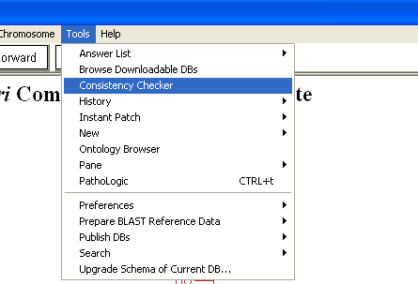
The Consistency Checker
Consistency Checking should be performed routinely (every few months), and problems should be addressed

Slide 5
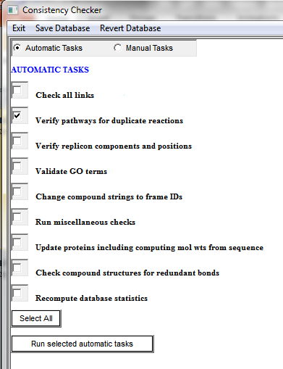
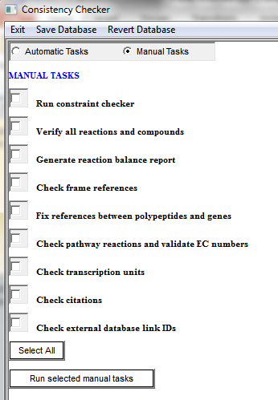
Automatic and Manual Tasks
I recommend running the automatic tasks first
I recommend running individual tasks, one at a time.
When you mouse over a task’s name, you will see documentation for that particular task in the bottom window pane

Slide 6

Consistency Checker Output
The output appears on the right pane, but is also saved into a text file in the reports directory. The name and location of the file are printed at the end of the output.

Slide 7
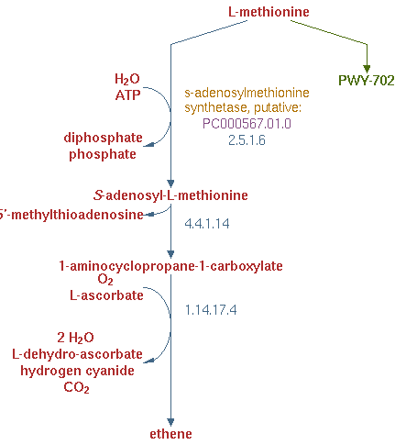
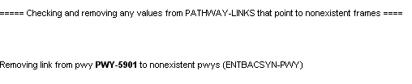
Automatic Tasks: Check all links
This tool looks at:
Inverse links (compound-reaction, gene-protein, etc)
Pathway links
Ghost reactions in pathways
Pathways included in other pathways

Slide 8
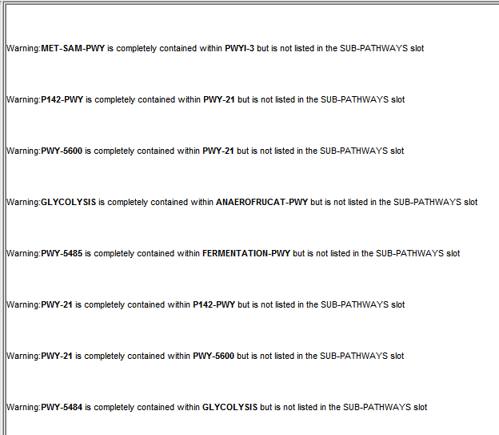
Automatic Tasks: Check all links
Warnings are not necessarily errors, but should be checked.
For example, PWY-21 is completely redundant to P142-PWY and should be deleted.

Slide 9
More Automatic Tasks
Verify pathways for duplicate reactions
Verify replicon components and positions: ensures all genes exist, sorts based on position.
Validate GO terms: updates the GO terms, removes obsolete ones.
Change compound names to string IDs: mostly applies to legacy data, where enzyme regulators may have been entered as text strings.

Slide 10
Yet More Automatic Tasks
Run miscellaneous checks: formatting glitches in names, sanity checks for superpathways, clears values of computed slots, deletes temporary frames created by the pathway editor
Update proteins: molecular weights
Check compound structures for redundant bonds

Slide 11
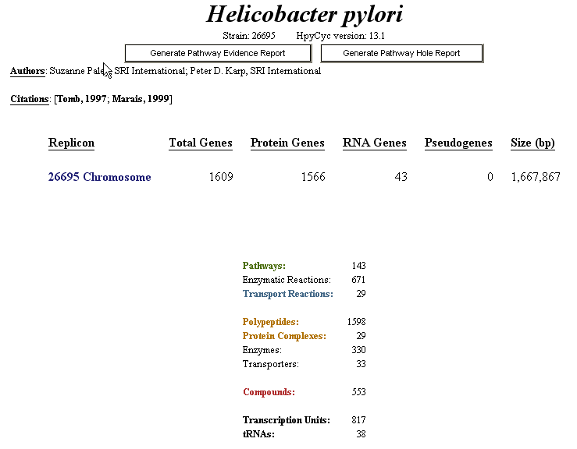
Automatic Tasks: Recompute database statistics
Its the only way to change the numbers on the home page

Slide 12
Manual Tasks: Run Constraint Checker
This tool usually requires the most time and effort for correcting the problems.
Flags constraints issues. For example, if a slot is supposed to contain only compound frames, but a different type of frame is listed among its values, the constraint checker identifies and flags the offensive value.
The opposite is true as well: the checker will flag that compound as present in a slot of a frame that is not suppose to have such a value.
(this means errors are often listed multiple times, under different frames)
The checker also flags cardinality violations. For example, cases where more than one value is present in a slot that is only allowed to have a single value.

Slide 13
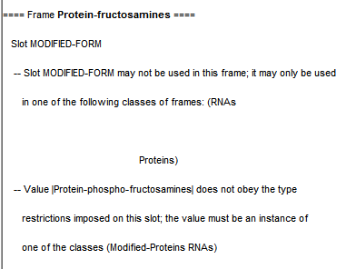
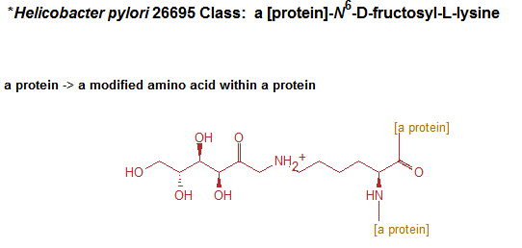
Run Constraint Checker
Error Reports: Example 1
Obviously, this frame used to be classified as a protein, but has been converted at some point to a chemical compound. Thus, it should no longer contain a Modified-Protein slot.

Slide 14
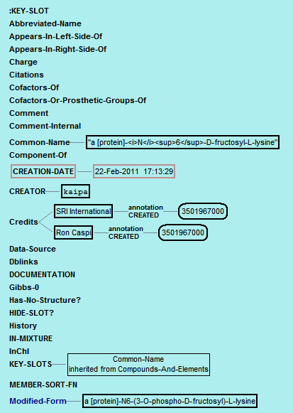
Fixing The Problem
The problematic slot shows up in blue. To solve the problem, highlight the attached value and remove it.

Slide 15
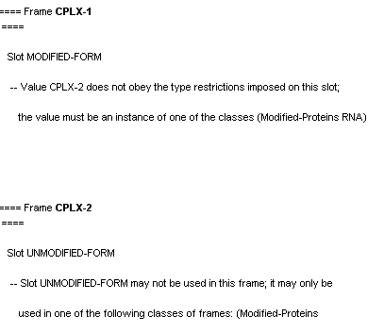
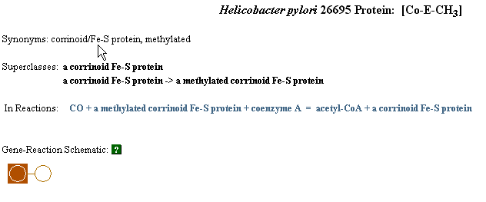
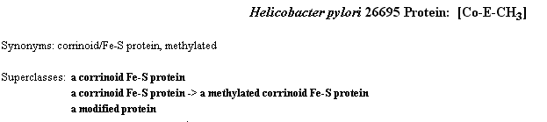
Constraint Error Reports: Example 2
The problem here is that CPLX-2, a modified form of CPLX-1, has not been classified as a modified protein. The solution is to open CPLX-2 in the Ontology Editor and add a link to the parent Modified-Proteins.

Slide 16
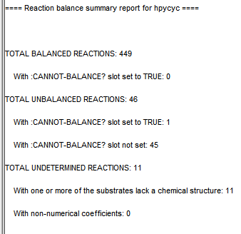
More Manual Tasks
Verify all reactions and compounds: finds defective enzymatic reaction frames (missing a protein, a reaction, or both); finds orphan reactions that are not associated with any other objects, looks for duplicate compounds.
Generate reaction balance report

Slide 17
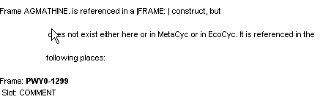

Frame References Error Report Example
Looking at that pathway’s comment, we find that the FRAME construct is missing the last bar.

Slide 18
More Manual Tasks
Fix references between polypeptide and genes: adds the gene value to modified proteins that miss it, adds a capitalized gene name to the synonyms list, and scans it for duplicates, flags orphan genes and proteins.
Check pathway reactions and validate EC numbers: checks the PREDECESSORS slot of pathway frames, flags deleted and transferred EC numbers.
Check transcription units: looks for invalid frames, Tus with no genes, with genes in different directions, etc.

Slide 19
Even More Manual Tasks
Check citations: tries to find formatting problems, reports pubmed citations that have not been imported, provides statistics.
Check external database link IDs: flags frames that are linked to the same external DB entry by links that are supposed to be unique.

Slide 20
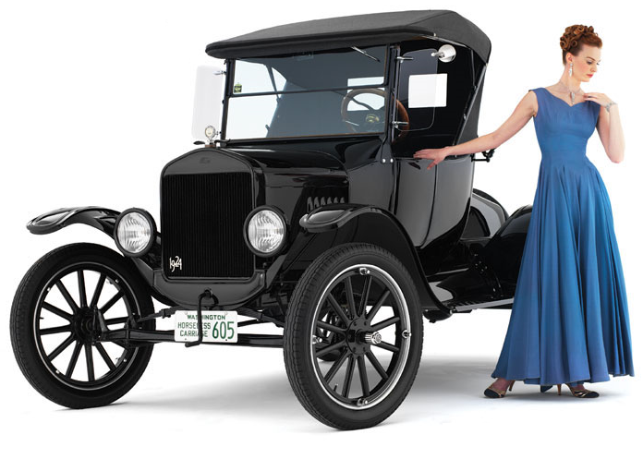
And When You Finish, take pride at your newly renovated PGDB!

