Slide 1
The Omics Dashboard

Slide 2
Omics Dashboard
Interactive tool for analysis of omics data
  Gene expression
  Proteomics
  Metabolomics
  Reaction fluxes
Use cases:
  Understand an omics dataset at multiple levels
  High-level survey of responses of many cellular systems
  Examine specific pathways, subsystems of interest in detail
  Visualization provides quick understanding of quantitative behavior
  Visually detect patterns missed by simple statistical filtering

Slide 3
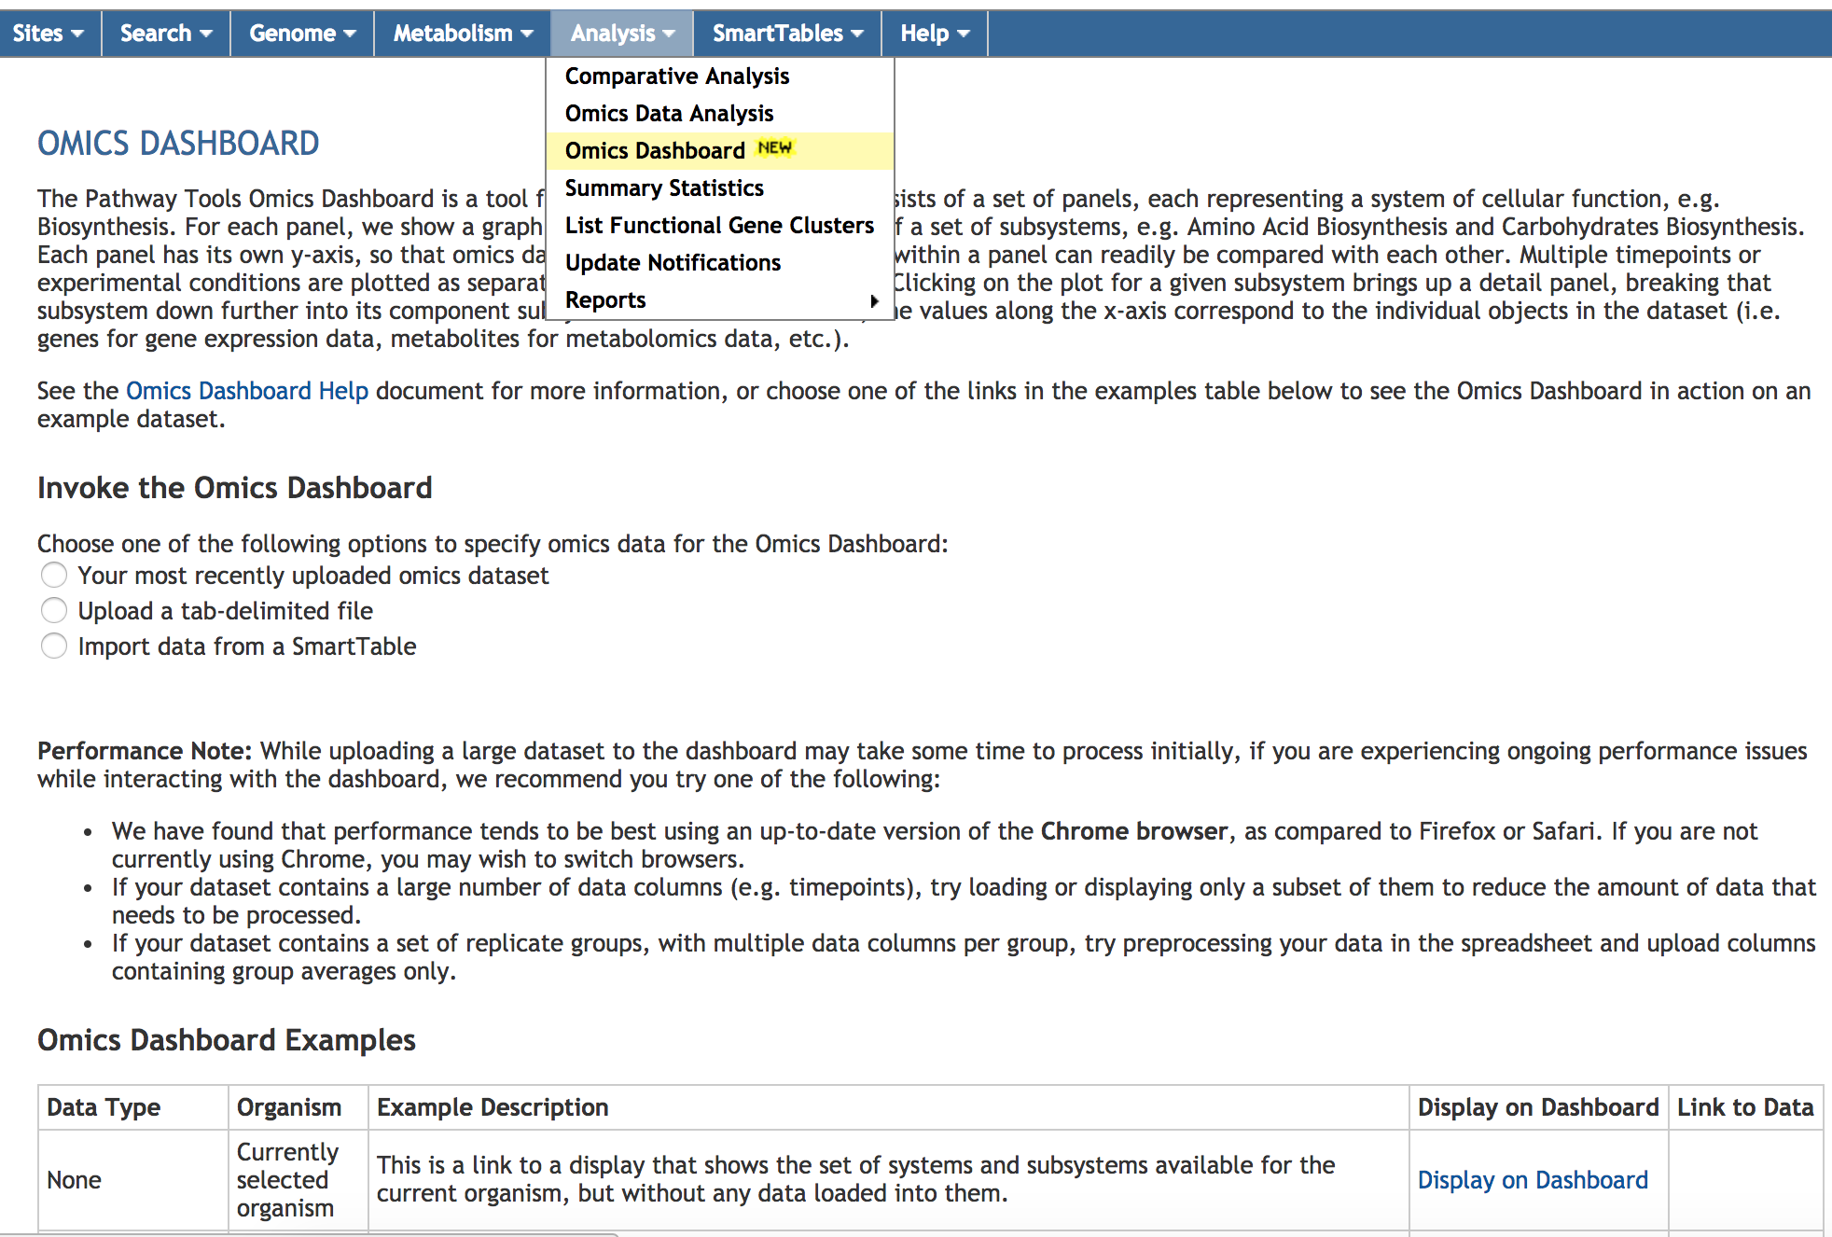
Accessing the Omics Dashboard

Slide 4
Sample Dataset
Escherichia coli transcriptomics data
  Von Wulffen et al Genes 8(3) 2017
10 minute time course following shift from anaerobic to aerobic growth
Normalized average RNA-seq read counts on Y-axis

Slide 5
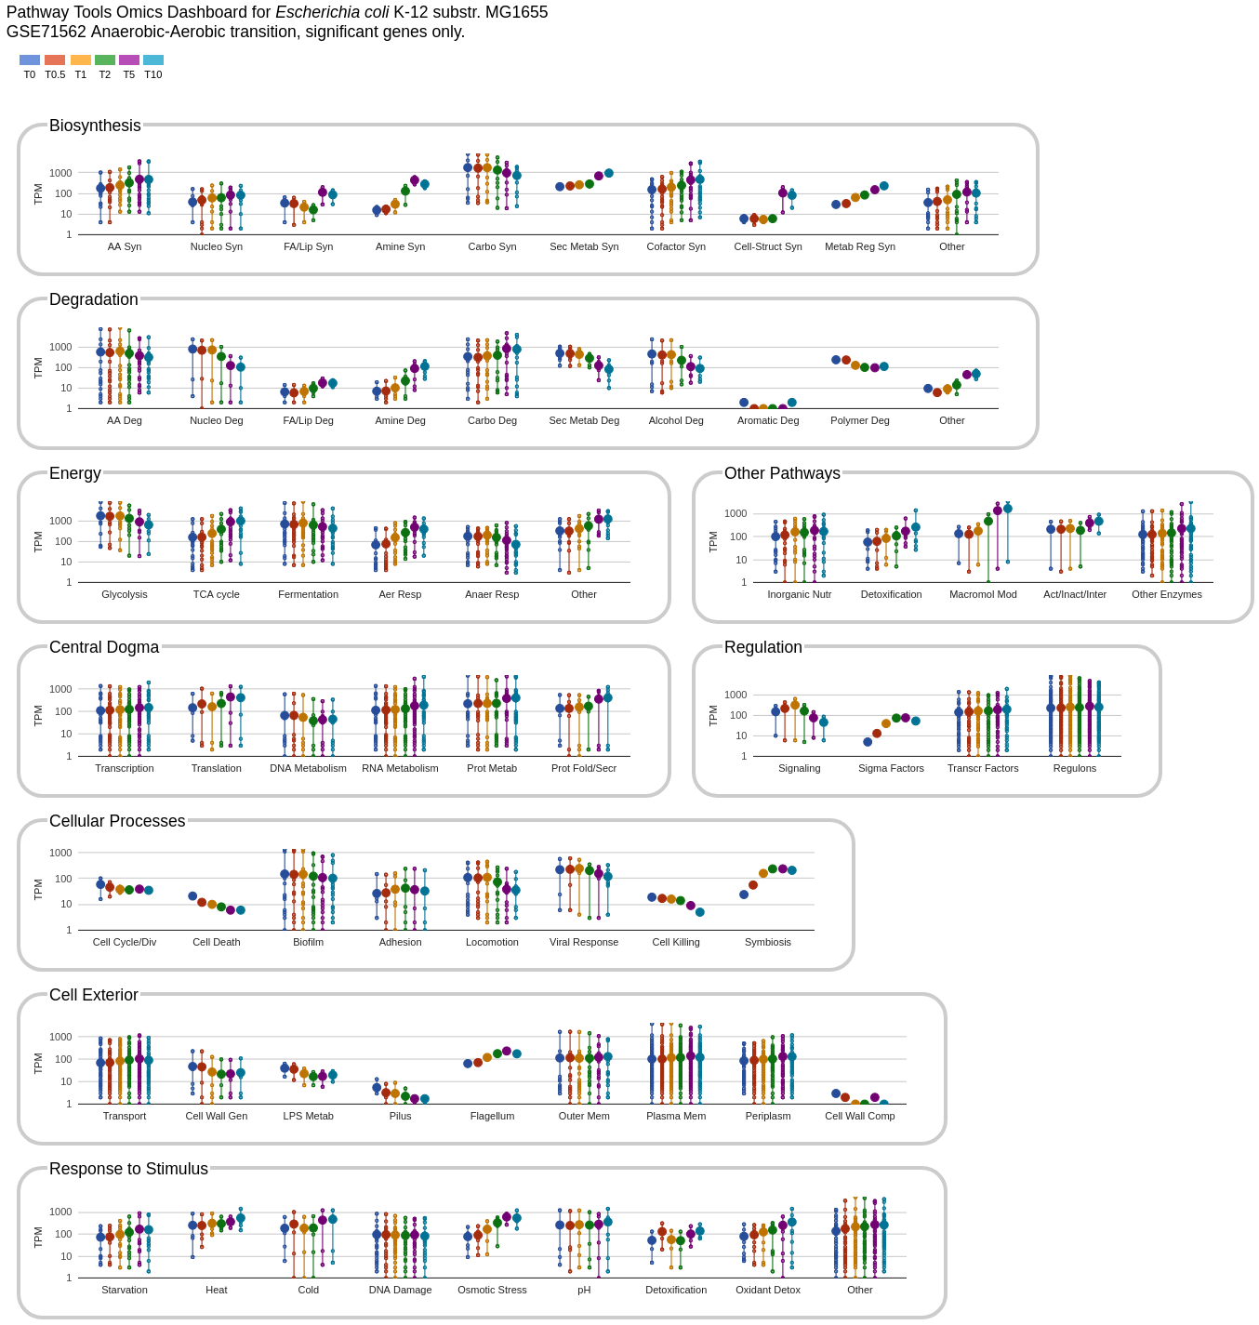
Organization of Omics Dashboard
A series of panels summarize omics data for different cellular systems
Each panel contains a set of plots (subsystems)
Implemented in JavaScript, using Google Charts
Notes:
Each point on a vertical line is a reading for one gene.
Set of metabolites on one vertical line are all genes in that subsystem for which data is available.
Large point is the average.

Slide 6
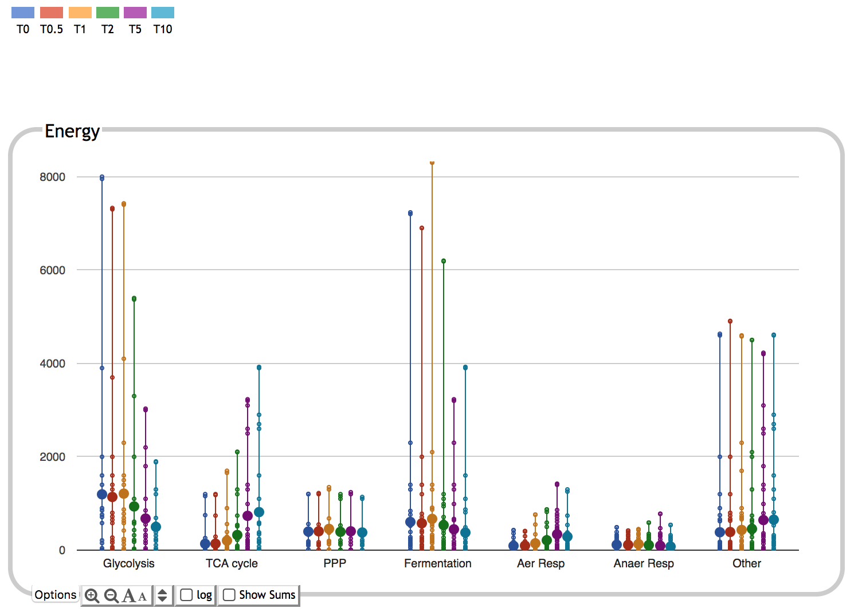
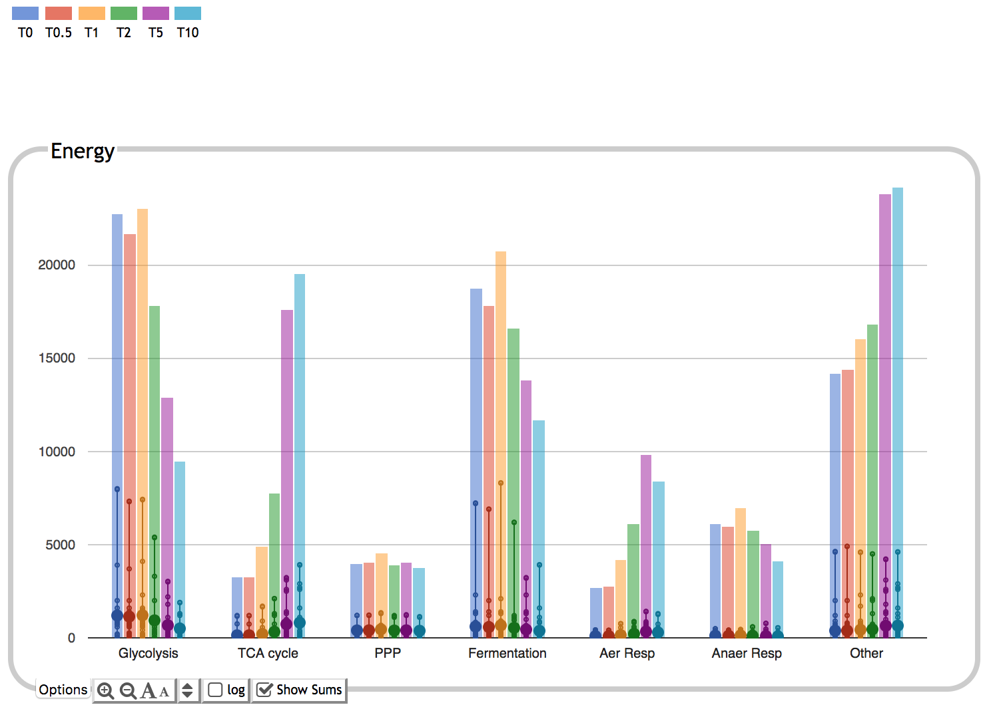
Colors correspond to timepoints
Bar height corresponds to sum of expression values for all genes in subsystem
Large dots show average over all genes in subsystem
Small dots correspond to individual gene expression values

Slide 7
Dashboard Systems and Subsystems
Derived from
  MetaCyc Pathway Ontology (355 classes, many individual pathways)
    E.g. Biosynthesis, Energy Metabolism, Cofactor Biosynthesis, TCA Cycle
  Gene Ontology terms (80 terms)
    Hand-curated subset, mostly Biological Process, some Cellular Component
    E.g. Response to Stimulus, Biofilm, Protein Folding, Outer Membrane Proteins
  Other
    Transporters, Regulons, Sigma Factors
Organism-specific
Dataset-specific
Users can add or remove plots from any panel
Users can create new subsystems from gene set, pathway set, GO term

Slide 8
Notes:
Four panels are metabolic, five panels are non-metabolic.

Slide 9
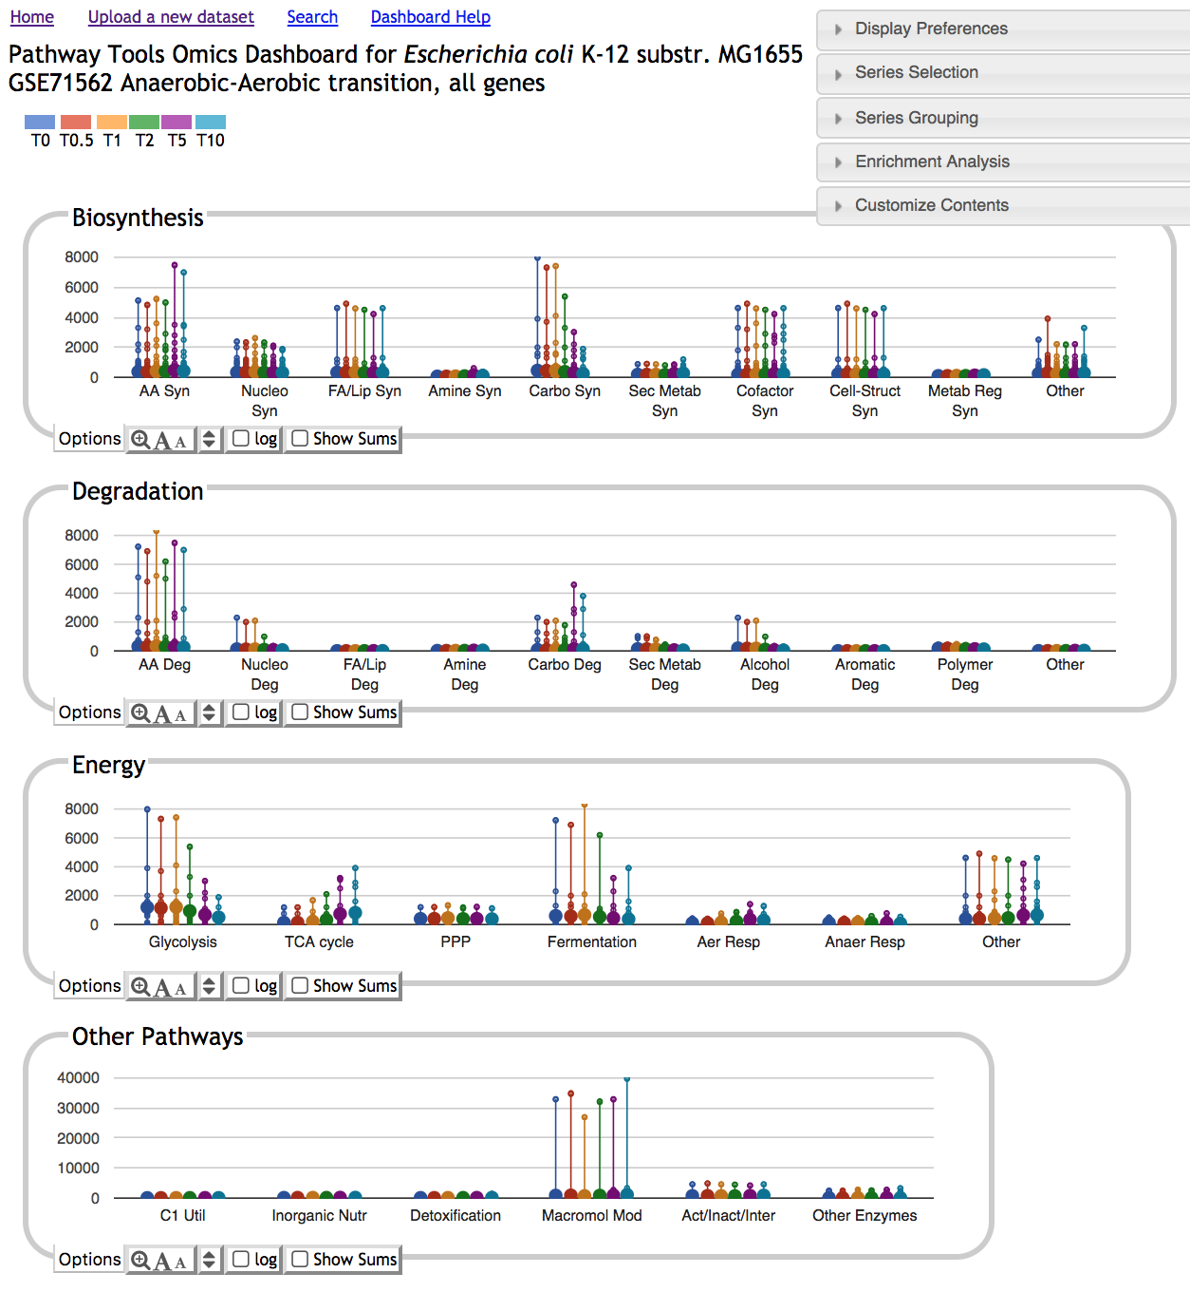
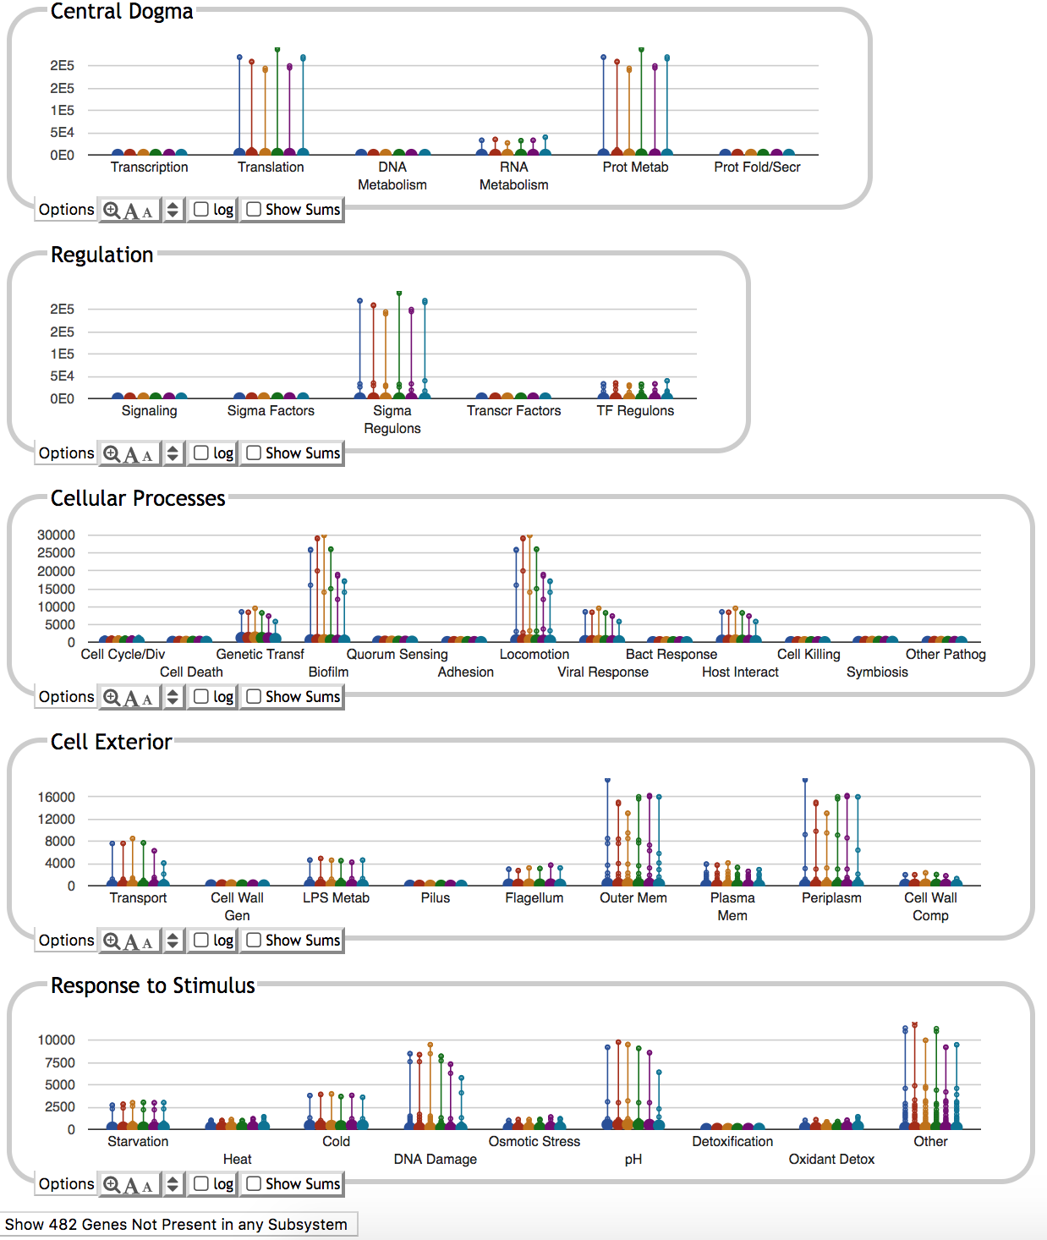
Dashboard Top Level Display

Slide 10
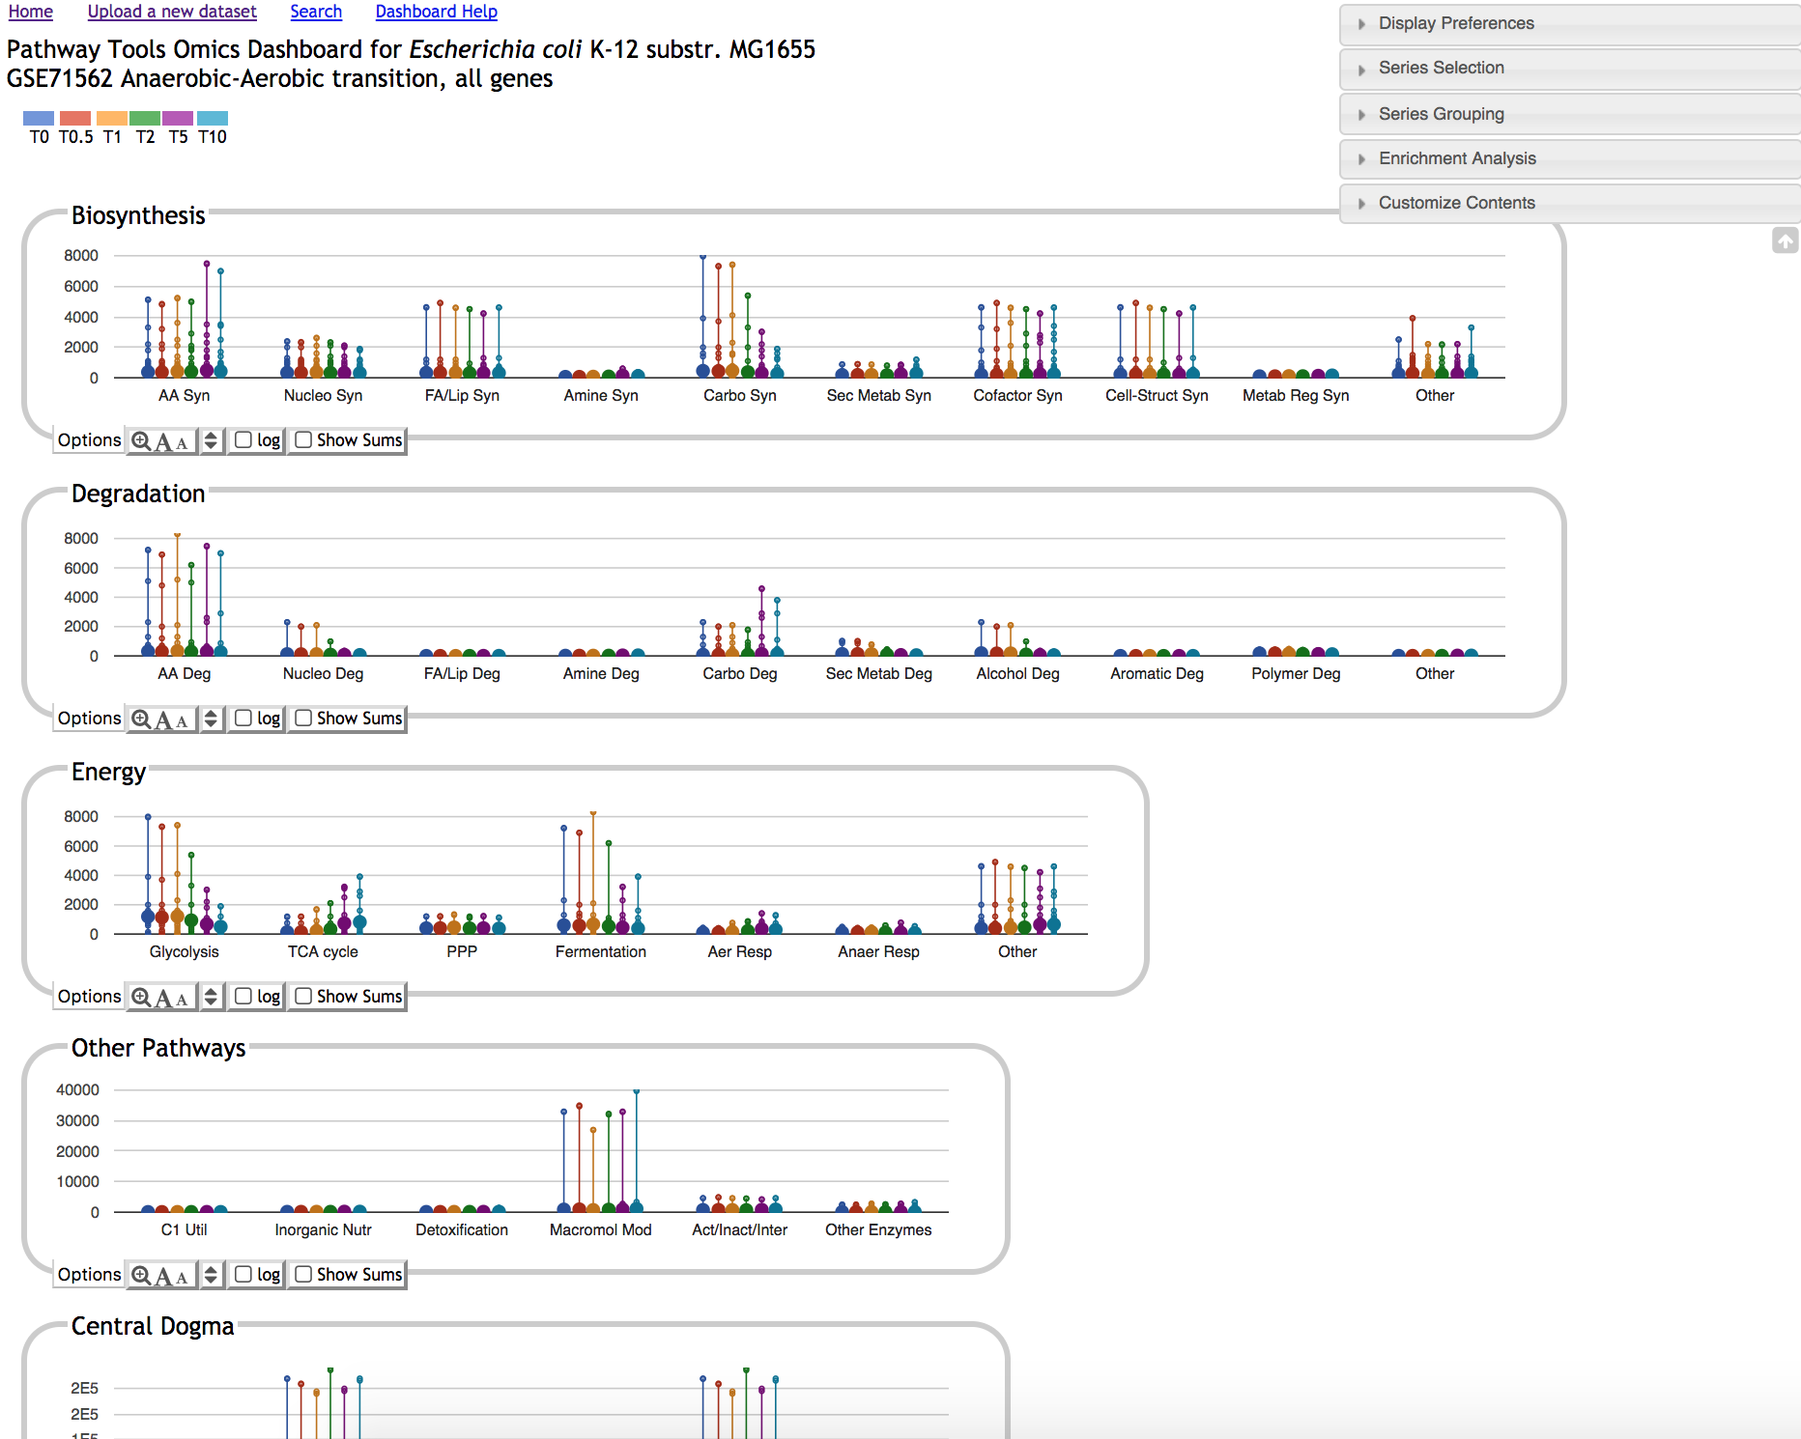
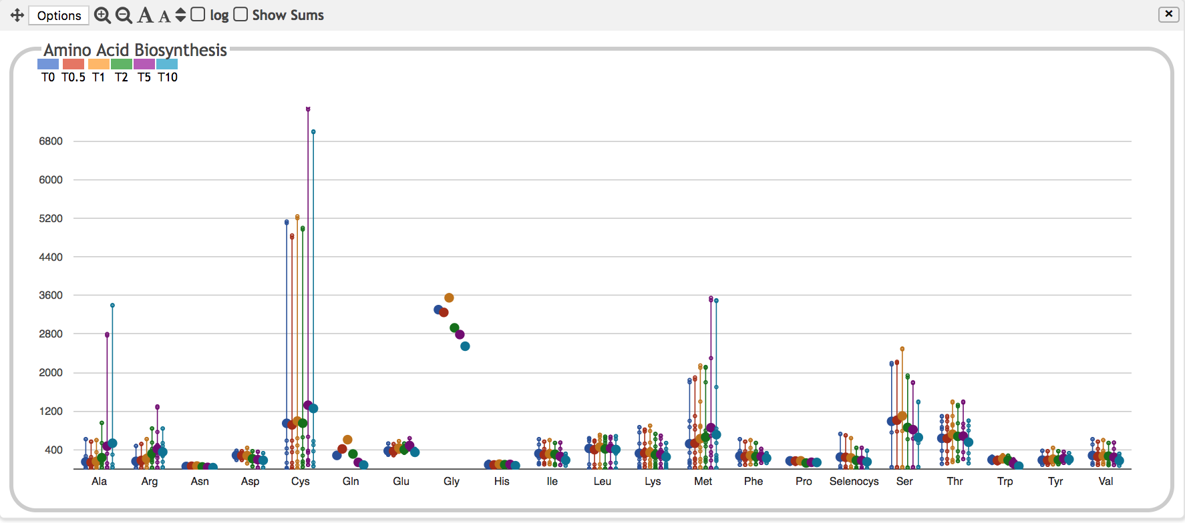
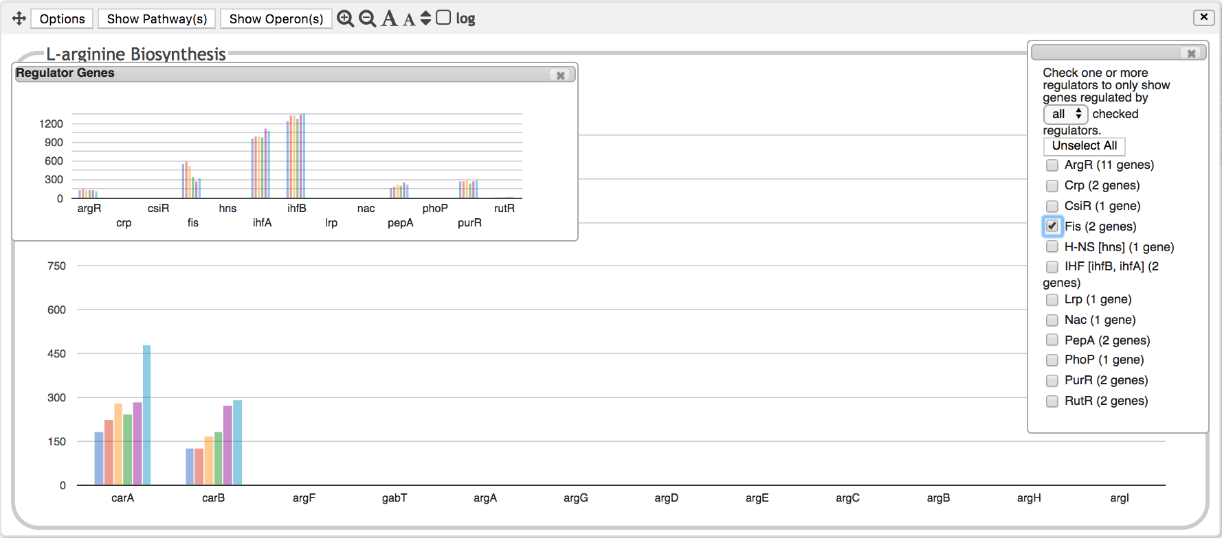
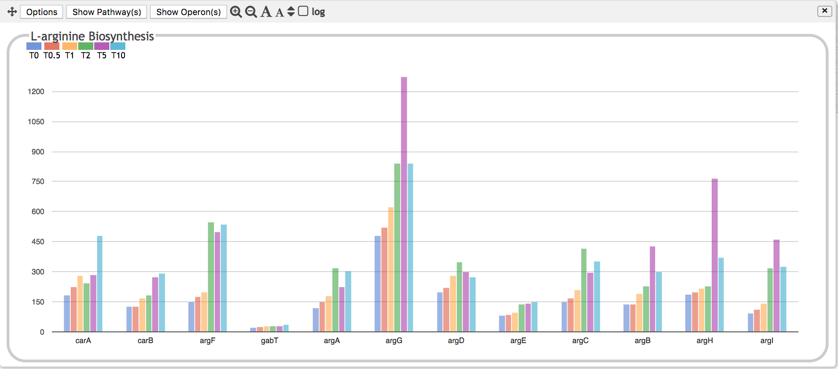
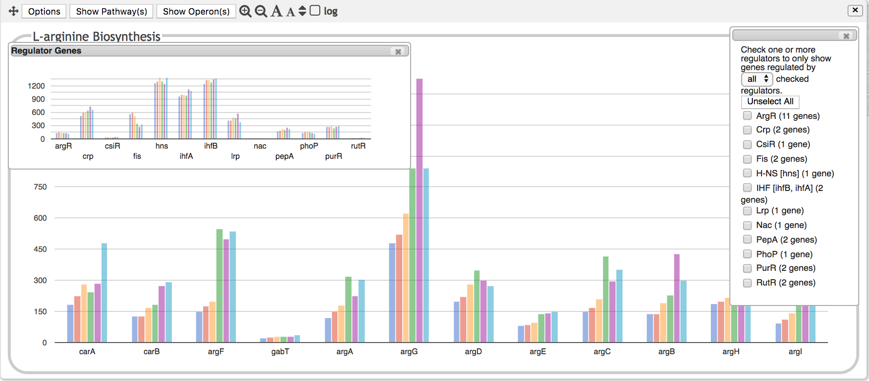
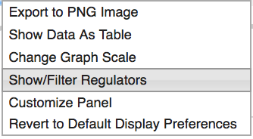
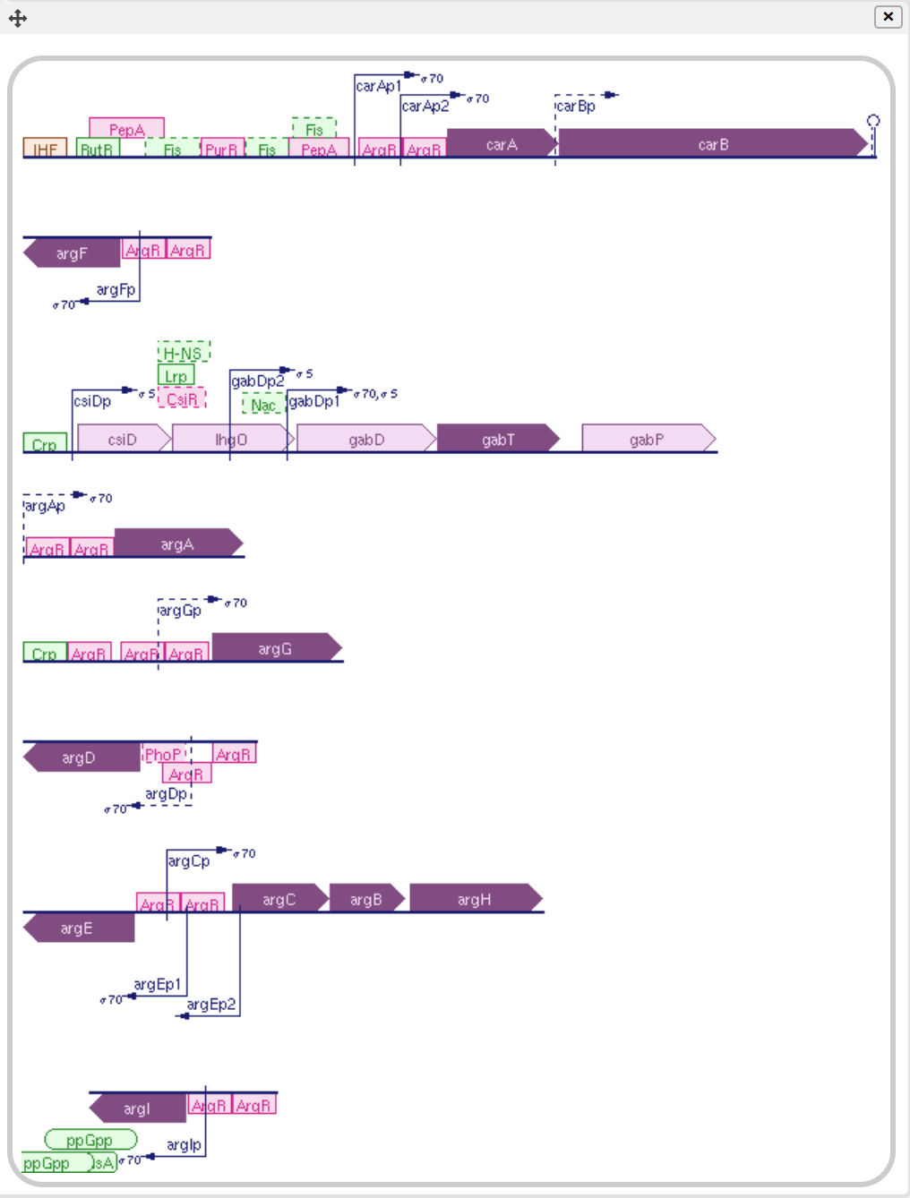
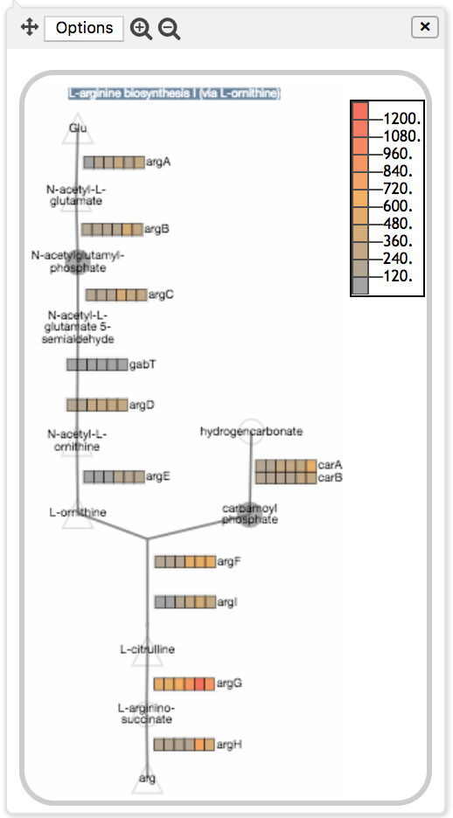

Slide 11
Other Capabilities
Choose log or linear scale
Customize panel size, vertical scale
Sort by gene position, alphabetical, data value
Select which data series to show/hide
Average data for multiple replicates
Perform enrichment analysis
Generate table of data for selected panel
Export to SmartTable

Slide 12
Using the Dashboard
Apply normalization and significance calculations before uploading data, if applicable.
Decide whether to average replicates before upload, or have dashboard do it for you (performance implications)
Import data as a column-delimited file
  Gene names/metabolite names/IDs in first column
  Specify which other columns contain data of interest
  Types of data values
    Fold change values
    Absolute quantities (counts, areas, intensities)
    P-values from replicate analysis (used for enrichment analysis)
Modify diagram scale as needed, choose log vs linear

Slide 13
Enrichment Analysis
Which systems have more perturbed genes than expected by chance?
User specifies
  A p-value column associated with each timepoint
  Threshold (0.05 in this example)
  Multiple hypothesis correction function
Compute enrichment score for every system, subsystem
  Fisher-exact hypergeometric test
  Enrichment score for a system = -log₁₀(p-value)
Panels show
  Enrichment scores for each system
  Highest component subsystem score

Slide 14
